Slide 1
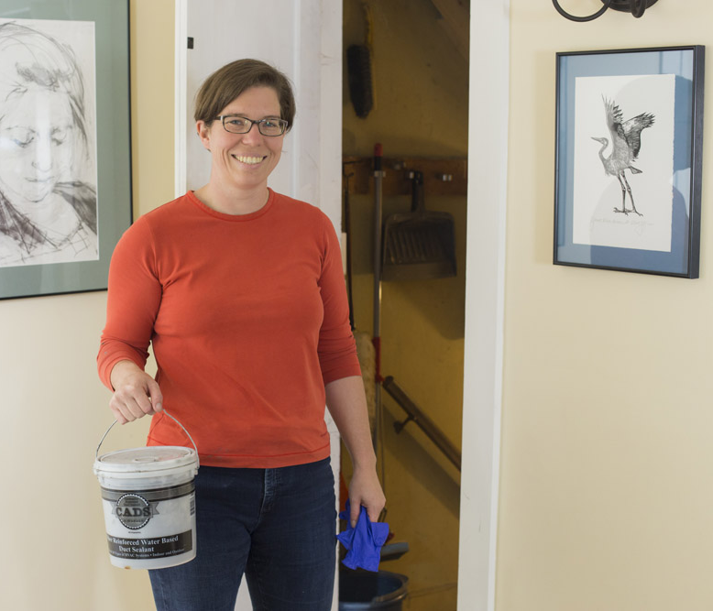
Button Up Vermont 2018
Regional Workshops for
Community Partners

Slide 2
Agenda
Button Up Vermont Overview
Engaging Community Members
Button Up Checklist and Free Products
Button Up website and social media
Break – collect educational and other materials
Button Up Hero – Deep Dive

Slide 3
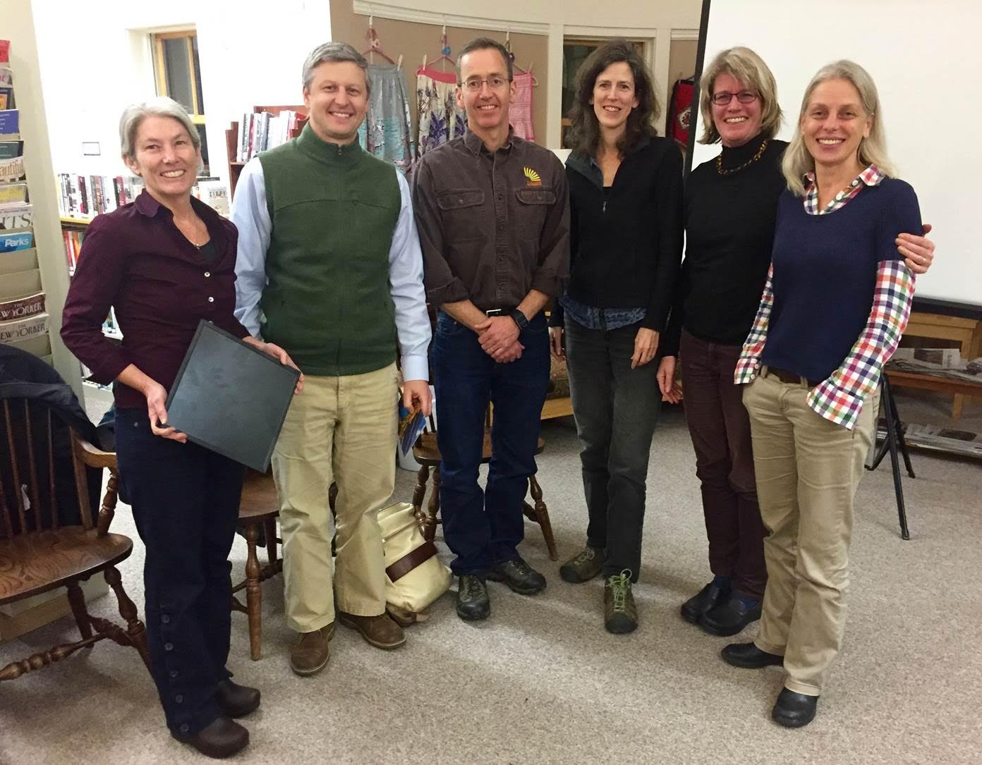
2018 Button Up Vermont Campaign
Multi-layered, integrated educational and outreach campaign focused around thermal efficiency
Web-based tools
Media/social media
Community-based component
Retailer and contractor engagement
Notes:
2nd year of EVT strong involvement in Button Up
Last year developed logo, website, community grants
This year expanded upon the effort

Slide 4
Button Up Vermont as a Third Party Brand
Button Up Vermont provides a unifying 3rd party brand
Statewide partners reinforce Button Up Vermont messaging
Statewide partners include electric and gas utilities, contractors, more
Notes:
Reinforcing the Button Up message through a wide-range of avenues
Partners include: GMP, VGS, BED, WEC, VEC, Neighborworks, VECAN, BPPA, VPPSA, more

Slide 5
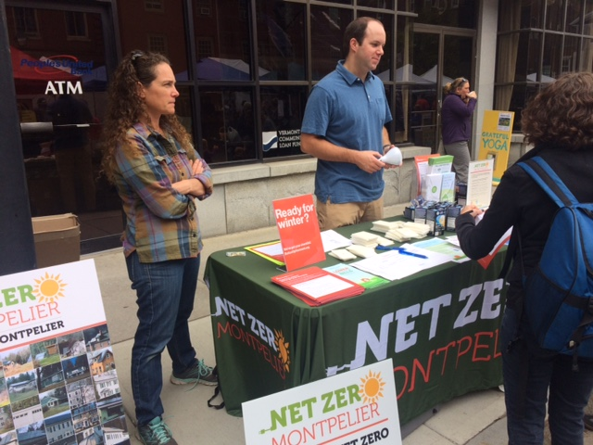
Options for Community Partners
Button Up Champs
Community partners undertake two engagement activities – direct interaction with residents
Distribute free products and educational materials
Efficiency Vermont provides broad range of support
Notes:
Button Up Champs Community Partners will:
Host two community engagement public events, where they will:
Distribute free energy efficient product kits to residents and property owners in exchange for residents/property owners committing to undertake at least one new energy efficiency measure/action in their homes. Agree to distribute only one packet of efficient products per household and to distribute efficient products only to Vermont residents/property owners;
Promote a checklist of energy-saving actions that residents/property owners can undertake to reduce heating and cooling costs; and,
Record the name and address of all individuals who receive free efficient product kit and provide this list to Efficiency Vermont. Note, by obtaining their full address, Efficiency Vermont can better support the homeowner in the future;∗
Prepare a brief narrative report at the conclusion of the program with information on completed activities and results ∗ If individuals object to putting their full contact information – then just the name is sufficient.
EVT will:
Hold informational calls & regional workshops for community partners: Several calls and workshops will be held throughout the state, and Efficiency Vermont will provide a handbook for partner communities;
Supply educational/promotional materials: Including posters, handouts, and educational materials to distribute to residents, as well as the Button Up Vermont checklist;
Provide free products to distribute: Communities will receive free energy efficient product kits to distribute to residents and homeowners. Energy efficient products kits include weather stripping, information about a new DIY offer, and a refrigerator thermometer;
Offer paid advertising: Efficiency Vermont will work directly with newspapers to provide paid advertising for one outreach event;
Update the Button Up website: ButtonUpVermont.org, which provides educational videos, tools for communities as well as individual residents.

Slide 6
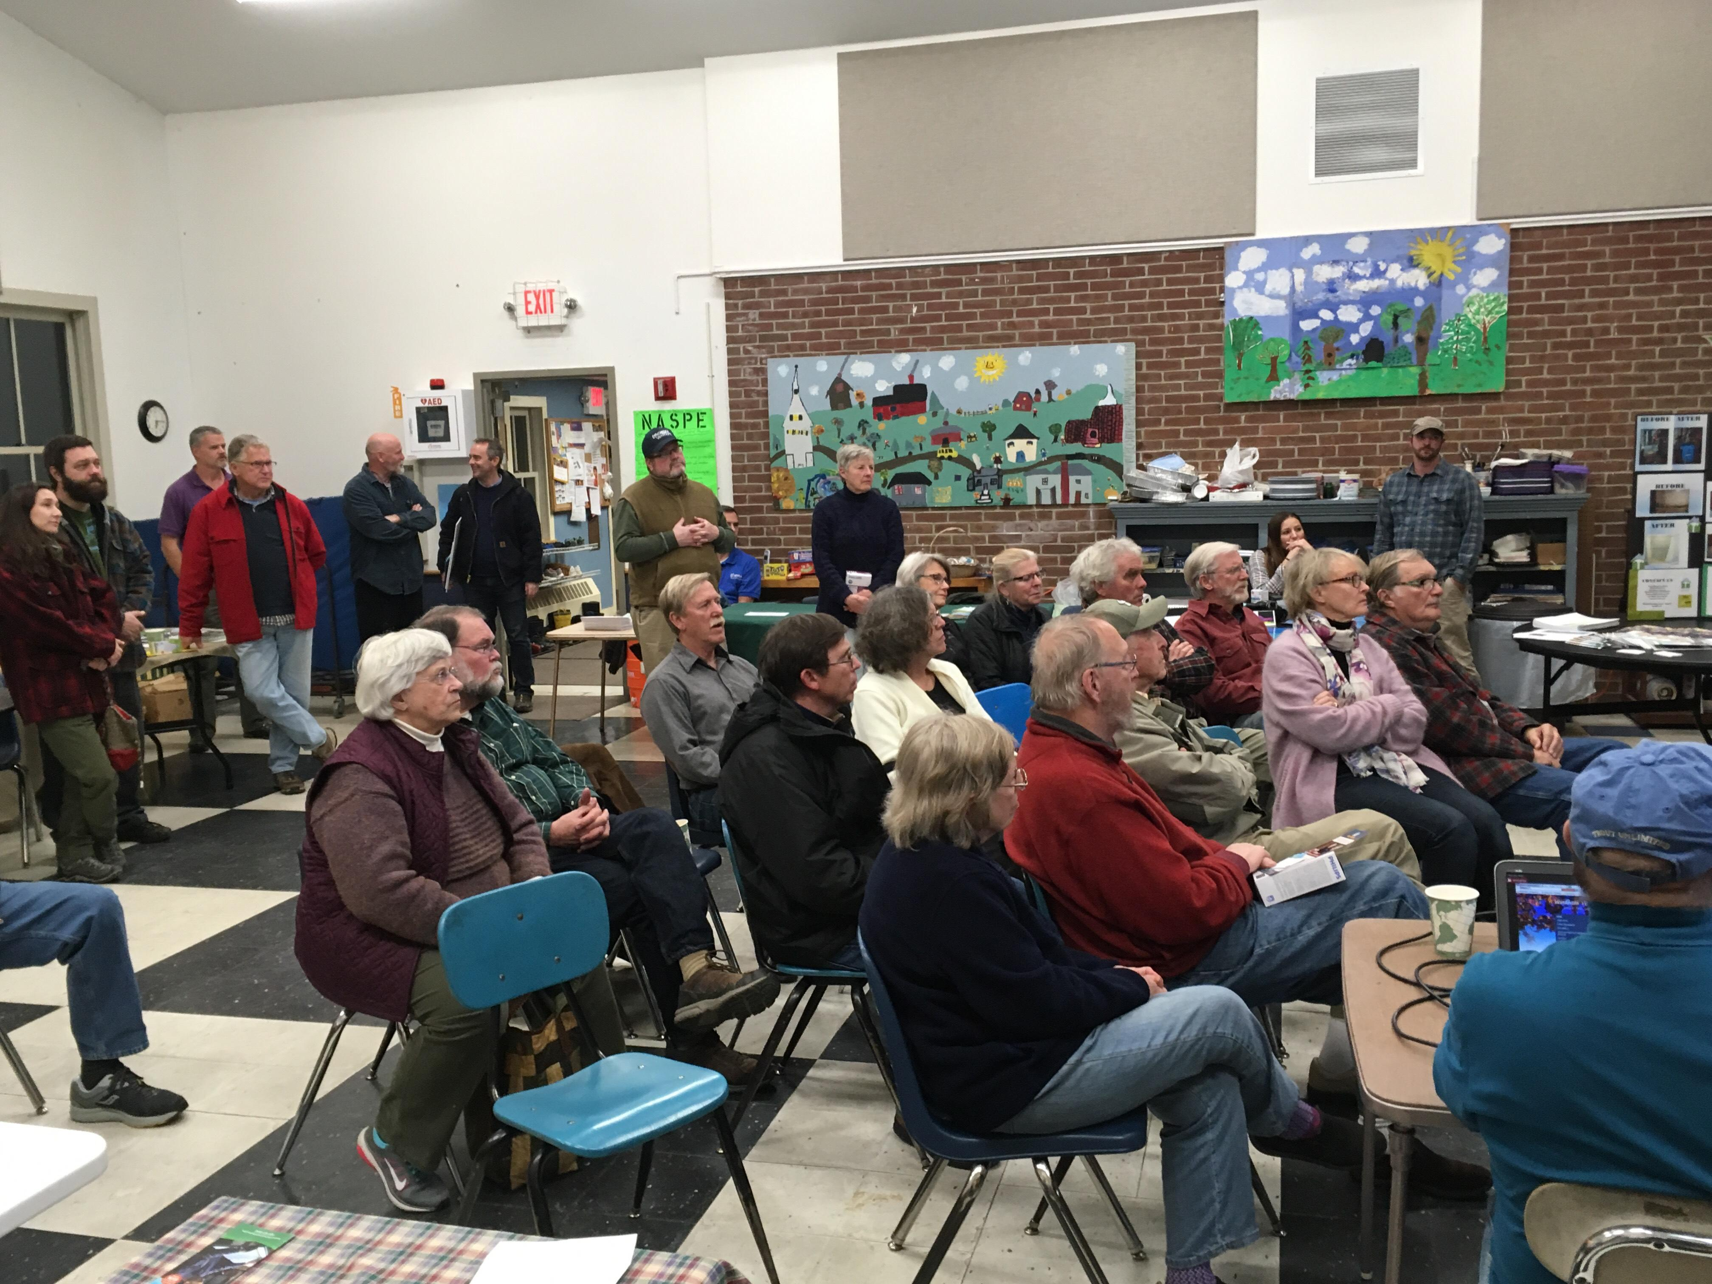
Options for Community Partners
Button Up Hero
Free walk-through and proposal from energy contractors for residents
Community partners:
Host kick-off event, conduct additional outreach and follow-up with residents
Provide free products and Button Up checklist
Notes:
Button Up Heros Community Partners will:
Commit to hosting a kick-off event for residents to encourage their participation.
The kick-off event includes participating contractors who will have an opportunity to speak and talk about their company, and residents have an opportunity to have 1:1 conversations with participating contractors.
This event can be done in partnership with participating neighboring communities.
Undertake additional public engagement activities with residents and homeowners, as described above.
Follow-up with residents who have received their work scope and cost estimate from the contractor to encourage them to move forward (additional guidance will be provided).
Distribute free energy efficient product kits to residents and property owners and record the names and contact individuals who receive a free energy efficient product kit, as described under the Button Up Champ options above.
EVT will:
Recruit participating contractors: Engage with contractors in the Efficiency Excellence Network (EEN) and encourage them to partner with community groups in their service territory to offer free walk-throughs;
Provide status updates: track participants and provide this data to community partners;
Supply campaign materials/tools: Provide sample agendas and press releases volunteer scripts, as well as lawn signs, table top posters, and a sample weatherization kit.

Slide 7
Engaging Community Members
What has worked for you?
Notes:
NEW SECTION

Slide 8
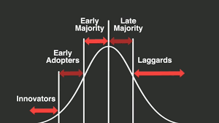
Technology Adoption Curve
Who are we trying to reach?
Notes:
Also known as Diffusion of Innovation or Innovation of Adoption lifecycle

Slide 9
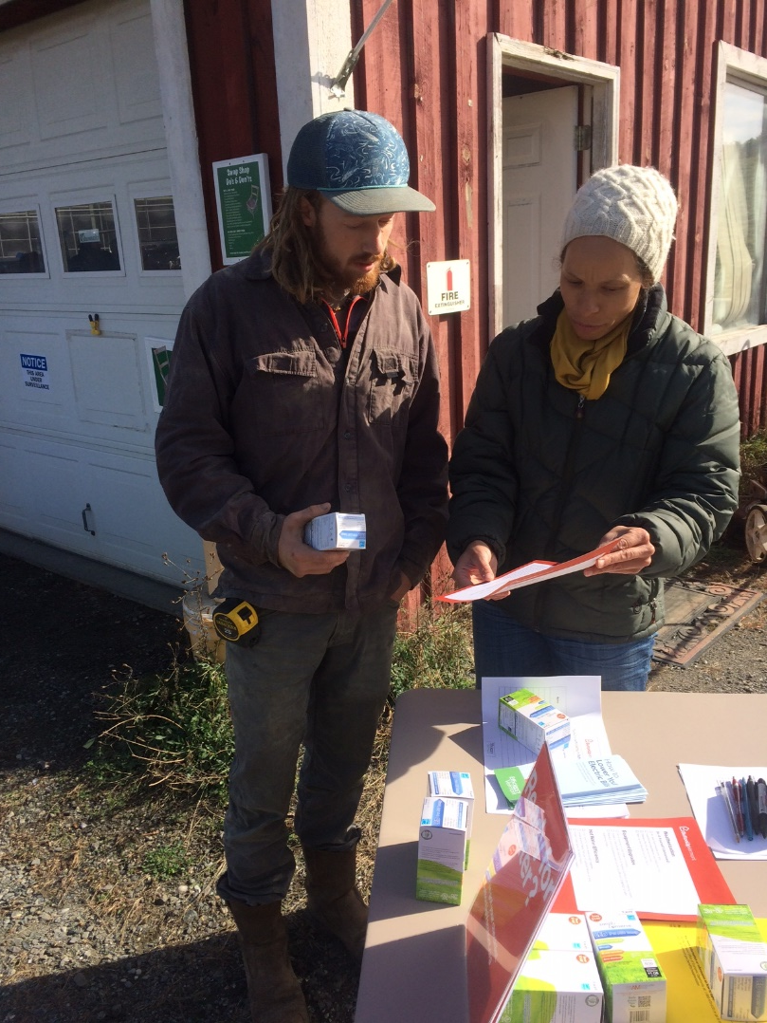
Engaging Community Members
Community Partners = trusted messenger
Personal interaction is key to convincing people to take action
Tabling at existing events - meet people where they are at
Hold energy events, e.g. workshops, house parties, kick-off event (for “Heroes”)
Notes:
Behavioral parlance – social diffusion, interpersonal communication
Tabling allows you to reach people who aren’t otherwise inclined or where energy concerns aren’t on the top of their mind

Slide 10
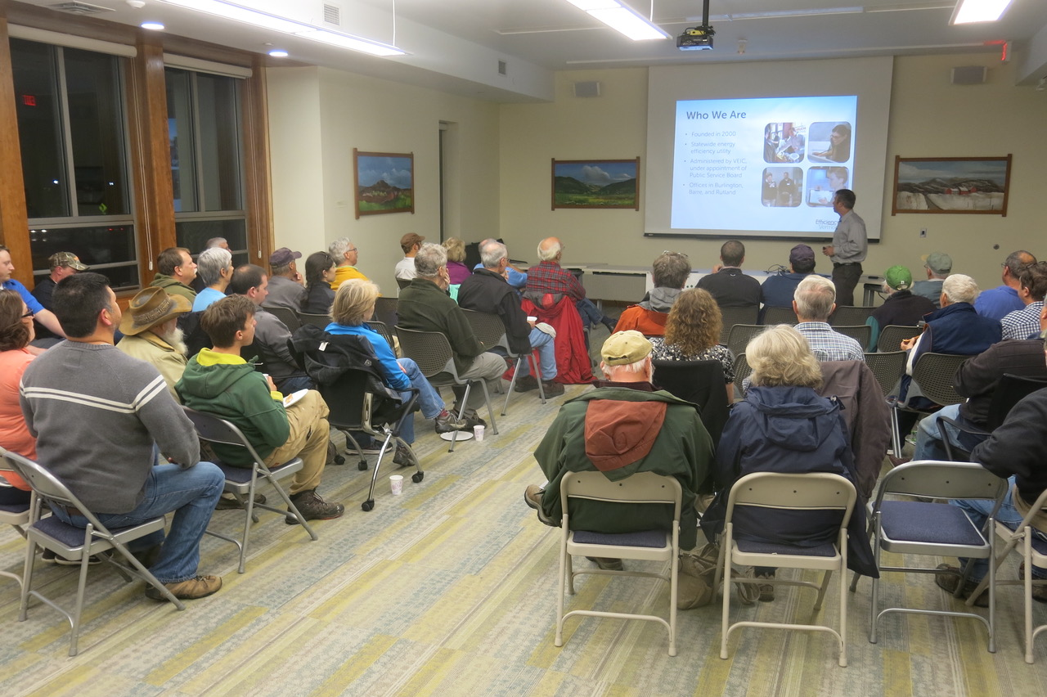
Energy Workshops
Button Up Vermont
Cold Climate Heat Pumps
DIY Home Energy Improvements
Healthy Homes
Mobile Home Efficiency
Modern Wood Heating
Slash Your Energy Bills
Zero Energy Homes
Link to sign up
Notes:
Behavioral parlance – social diffusion, interpersonal communication

Slide 11
Button Up Checklist
Engaging community members to take action
Message: Everyone can do something to reduce heating costs
Geared for renters and homeowners alike
Actions range from no-cost to comprehensive improvements
Efficiency Vermont is offering up to $100 rebates for weatherization products and up to $2000 for comprehensive work
Notes:
NEW SECTION

Slide 12
“The Pitch”
Residents commit to taking action and get free efficient products
Notes:
Free products and Button Up Vermont checklist
Utilizes behavioral tools of:
Free and reciprocity – i.e. if someone gets something for free that want to do something in return
Commitment – people are more likely to take action if they make a commitment, and even more likely to take action if they write down their committement
Individuals receive free products, put name on sign-up sheet, and take Button Up Vermont checklist
Individuals make a commitment to take at least one action to reduce heating and cooling cost in their homes
Efficiency Vermont tracks participants over time

Slide 13
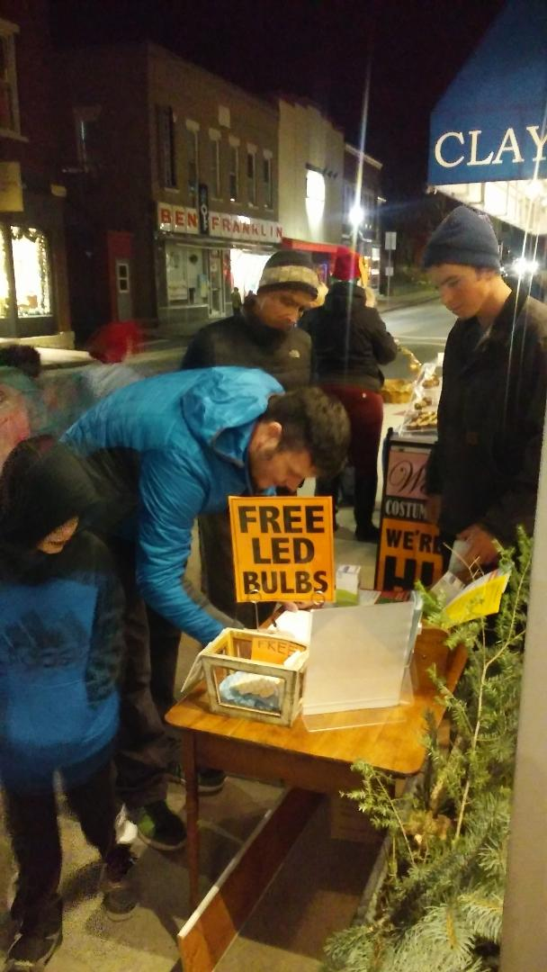
Distribution of Free Efficient Products
Free products: weather stripping and refrigerator thermometers
Community members commit to undertaking at least one action
One set of products per household
Distribute only to Vermont residents
Collect names and provide to Efficiency Vermont

Slide 14
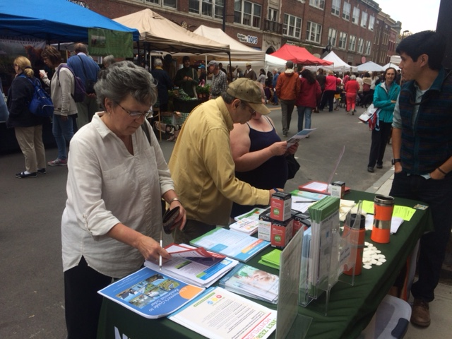
Button Up Vermont website
Button Up Vermont website
Guidance docs for Community Partners
Events listing – be sure to post all your events (even tabling)
Listing of Community Partners

Slide 15
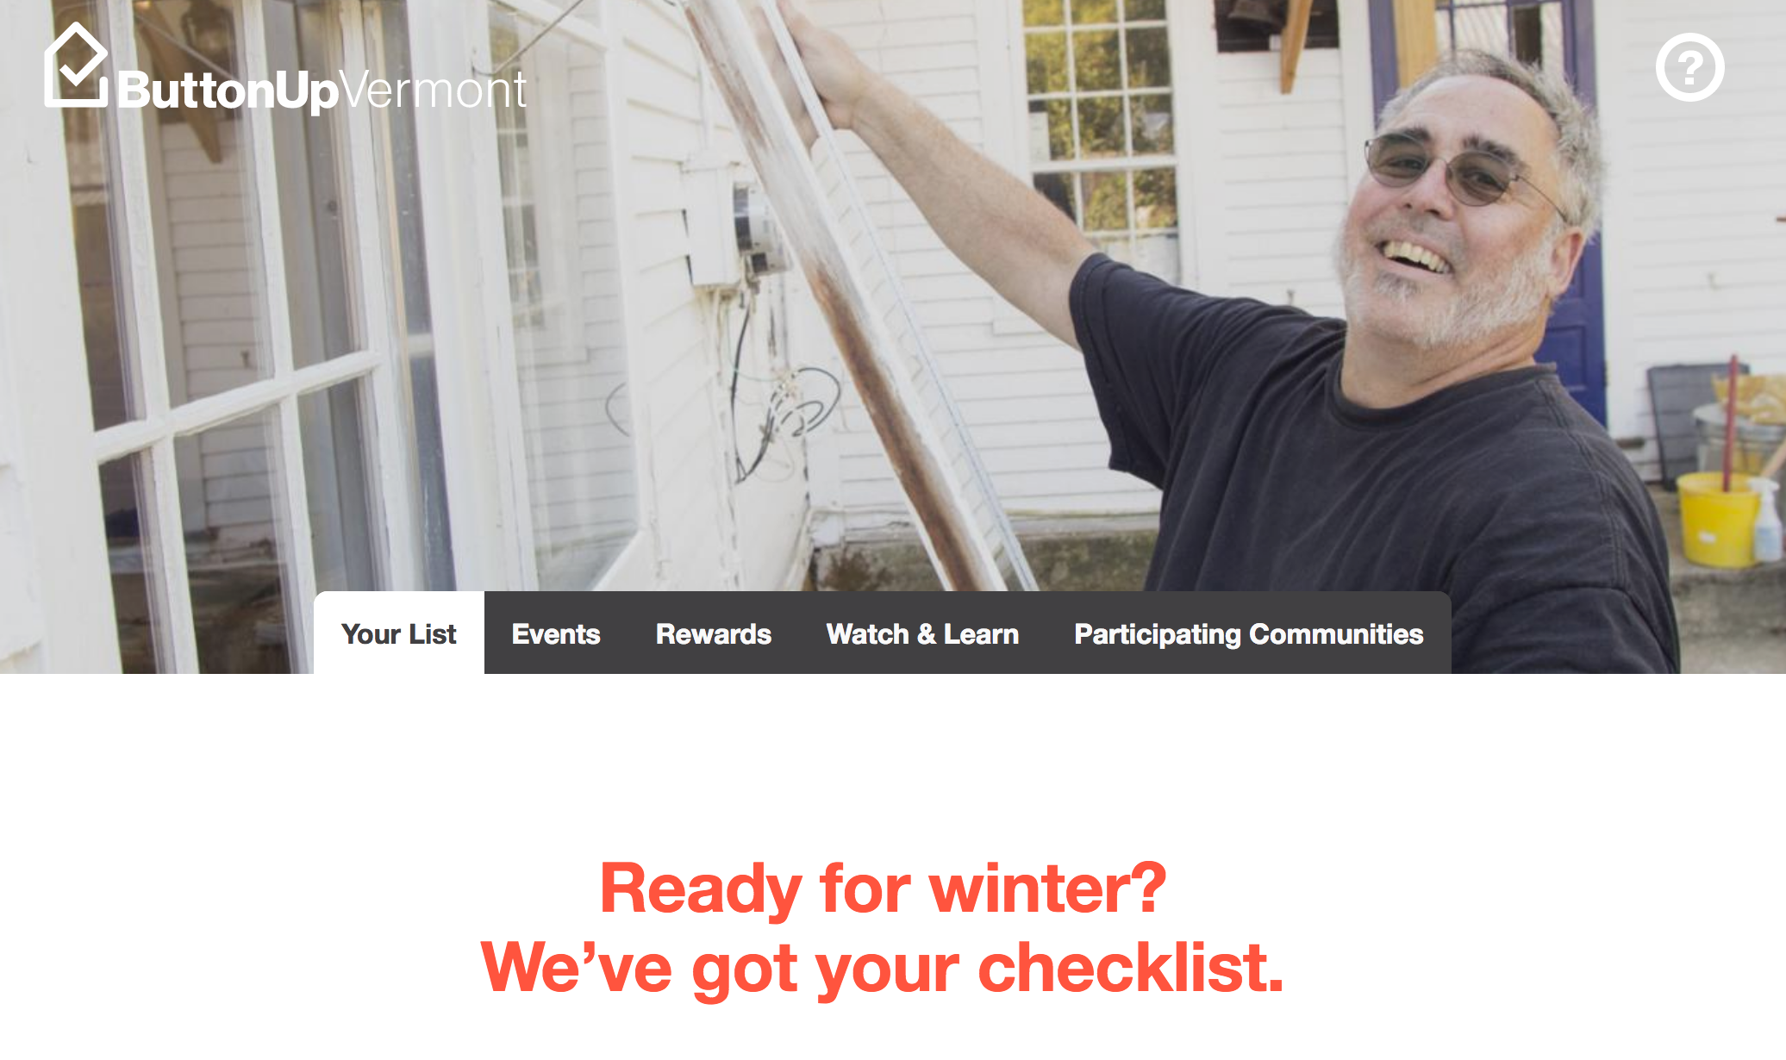

Slide 16
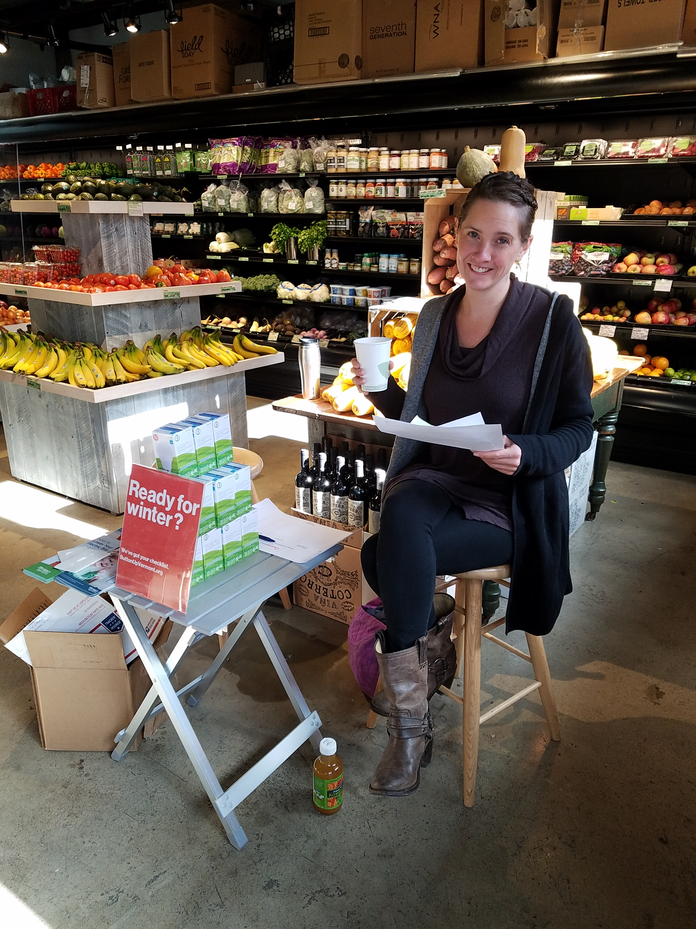
Social Media +
Social media -- focus on Facebook
Efficiency Vermont will provide content to Community Partners
Efficiency Vermont will cover cost of advertising one event in local newspaper
Share your ideas on the Button Up Community Partner listserve
Take high quality photos and send
Notes:
Focus on Facebook – based upon results of last year
Efficiency Vermont provides content to partners who post on their websites
EVT also has access to some partners Facebook pages wherein we can post directly
EVT also provides paid advertising for community partner events

Slide 17
BREAK
Get your materials!

Slide 18
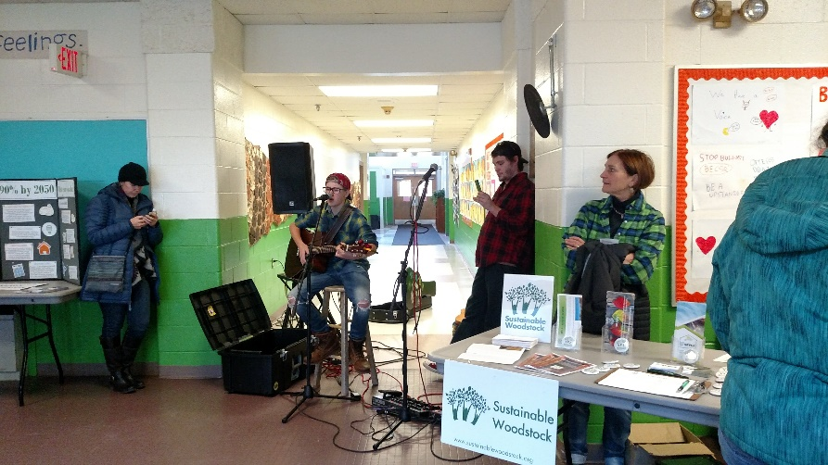
Button Up Hero
Free walk-through and proposal from energy contractors
Community partners:
Host kick-off event, conduct additional outreach and follow-up with residents
Provide free products and Button Up checklist
Notes:
Distribute Button Up Team Handbook
Button Up Heros Community Partners will:
Commit to hosting a kick-off event for residents to encourage their participation.
The kick-off event includes participating contractors who will have an opportunity to speak and talk about their company, and residents have an opportunity to have 1:1 conversations with participating contractors.
This event can be done in partnership with participating neighboring communities.
Undertake additional public engagement activities with residents and homeowners, as described above.
Follow-up with residents who have received their work scope and cost estimate from the contractor to encourage them to move forward (additional guidance will be provided).
Distribute free energy efficient product kits to residents and property owners and record the names and contact individuals who receive a free energy efficient product kit, as described under the Button Up Champ options above.
EVT will:
Recruit participating contractors: Engage with contractors in the Efficiency Excellence Network (EEN) and encourage them to partner with community groups in their service territory to offer free walk-throughs;
Provide status updates: track participants and provide this data to community partners;
Supply campaign materials/tools: Provide sample agendas and press releases volunteer scripts, as well as lawn signs, table top posters, and a sample weatherization kit.

Slide 19
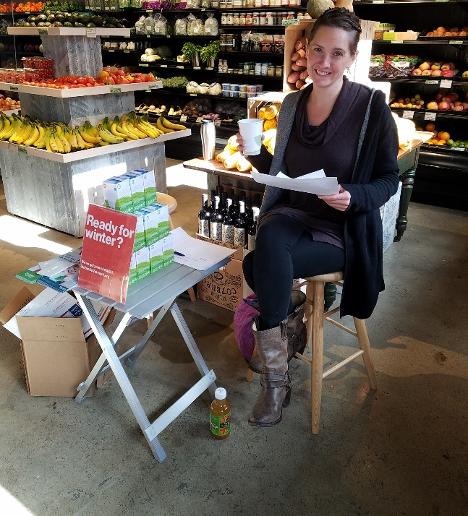
Customer Sign-Up
Community partners - drive residents to sign up
Customer completes on-line survey (hard copies available too)
Information about home characteristics and energy use, and select contractor
Contractors signed up for each community
Contractor, customer, and Efficiency Vermont get a copy of customer survey

Slide 20
Customer Follow-Up
Contractor responds to homeowner within 3 days and sets up time for walk-through
Efficiency Vermont will provide Community Partners with list of individuals who sign-up for walk-through and where they are in the process
Efficiency Vermont will coordinate with contractors
Community Partners follow-up with customers to encourage them to move forward

Slide 21
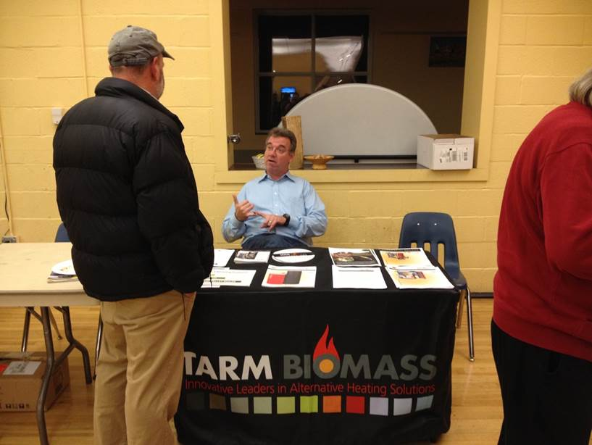
Contractor Walk-Through/Proposal
Visual assessment of energy saving opportunities (i.e. air sealing and insulation)
No blower door
Takes 1 – 1 ½ hours
Customer should be present
Contractor provides free proposal with scope, and estimated savings and cost
Notes:
Is this an energy audit?

Slide 22
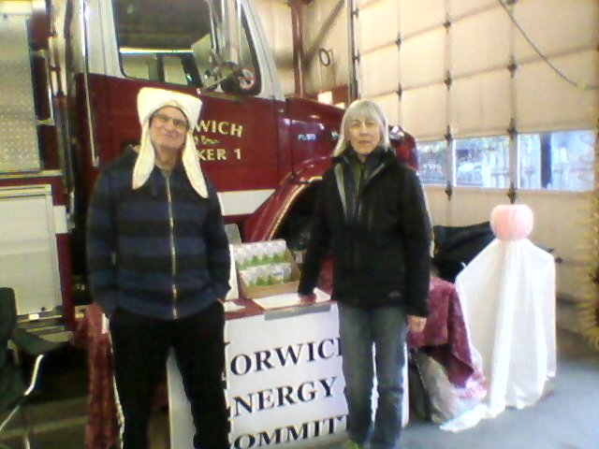
Kick-Off Event
Agenda
Welcome and Introductions
Button Up Presentation
Local champions
Meet the Contractors
Q&A
Chat with contractors
Notes:
Event Agenda and Script
Welcome and Introductions (Community Partner)
Button Up Presentation – (Efficiency Vermont)
Local champions share their story
Meet the Contractors –
Q&A
Stick around, mingle, and chat with contractors
Welcome and Introductions (10 min) – Team MC
Welcome, Housekeeping (bathrooms, exits, etc.), Thank you’s (e.g. venue, food)
Recognize key people (volunteers, contractors, champions, sponsors)
Explain how the volunteers got involved in Button Up and why you are excited about it
Explain the sign-up form on their seat and point to the resource table
Review the agenda and introduce presenter
Button Up Presentation (20-30 min) – Presenter from Efficiency Vermont
Meet the Contractors (8 min) - Each contractor gets a minute or two to introduce themselves
(IF APPLICABLE) Introduce Champions to briefly share their story (10 min) – Identify one or two neighbors who have had energy work done and had a good experience. Each can speak for a few minutes about what work was done, why, and what the benefits have been.
Q&A (15-20 min) – Team MC moderates; contractors and presenter answer questions
Wrap Up (5 min) – Team MC; try to wrap up no more than 90 mins after you started
Reminder to complete sign up forms, stick around to chat, and tell their friends
Stick around, mingle, and chat with contractors (20-40mins)

Slide 23
Timeline
Milestones | Timeline
Team organizing, training, and planning | September – October
Promote and host kick-off events | Late October – early November
Additional outreach to community members | October – December 15
Sign-up deadline for free walk-through | December 15
Contractors conduct free walk-throughs | October 1 – March 15
Volunteers reach out to participants | November – mid-April 2019
Residents make commitment to move forward (eligible to win prize) | April 22, 2019 (Earth Day)

Slide 24
Questions?
Paul Markowitz
Community Engagement Account Manager
Efficiency Vermont
802 540 7608
pmarkowitz@veic.org
www.efficiencyvermont.com

