Slide 1
Vermont’s Education Funding System
Jake Feldman – Research Statistician
Vermont Department of Taxes
Division of Policy, Outreach, and Legislative Affairs (POLA)

Slide 2
Before 1997, the amount of money a town could raise for education mostly depended on the amount of property value in the town, regardless of the number of students.
A
Town A can generate much more revenue than town B at the same tax rate.
B

Slide 3
The Department of Education reported that in 1997, property tax rates ranged from a
low of $0.12* to fund local education spending at $12,300 per pupil to a high of $2.28* to fund $7,850 per pupil.
From Mark Perrault’s testimony to House Education on 2/08/17 – “A Very Short History of Education Finance Prior to the Brigham Decision.”

Slide 4
In 1997, a group of parents and students sued the State of Vermont claiming the system was unfair. Vermont’s Supreme Court agreed, forcing the legislature to correct the inequity. This landmark decision is known as “The Brigham Decision” after the name of one of the Plaintiffs.
B

Slide 5
Act 60 of 1997 created a funding system to ensure that Vermont students are afforded “substantially equal access to a quality basic education.” A state “education fund” was established to collect all property tax revenue and redistribute it based on locally-voted budgets.
A
B

Slide 6
Since Act 60, each of the town’s districts receives its budget, no matter the amount of property value in the town(s).
However, a town’s homestead tax rate is scaled by how much the town spends per pupil.
And per-pupil spending above an “excess spending threshold” is double counted when determining tax rates.

Slide 7
So the tax rate in a town depends on what the town spends per-pupil:
1997
A town that spends the same total amount from year to year, but has a decline in pupils, will see tax rates go up.
2007
2017

Slide 8
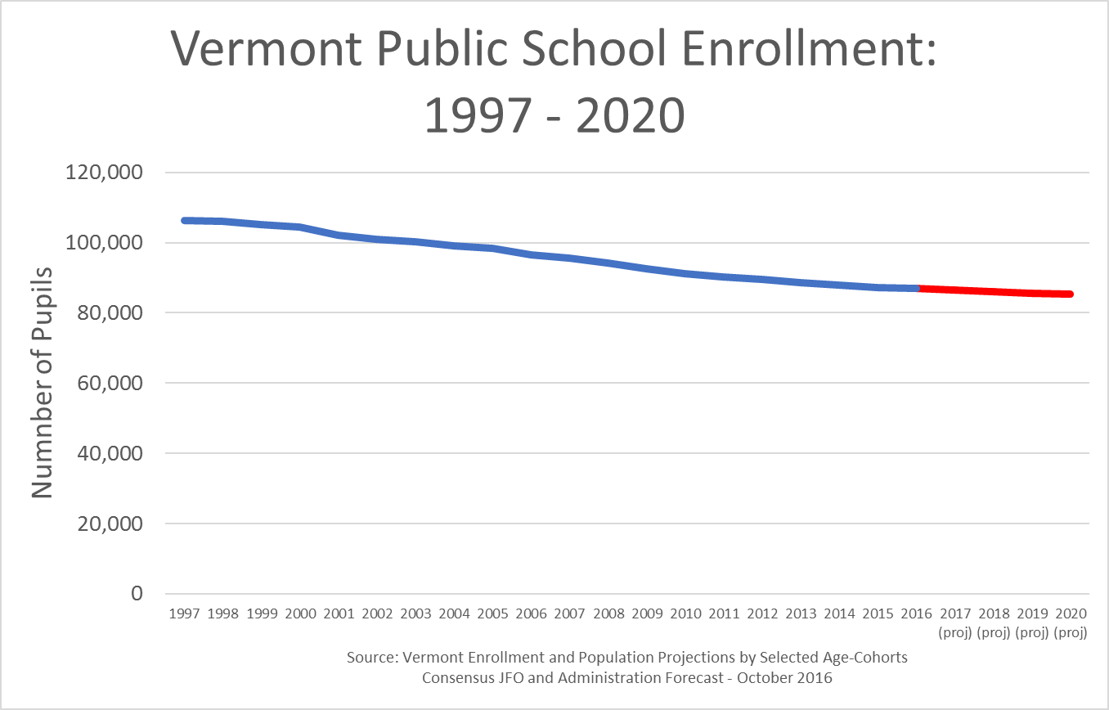
Declining enrollment is a problem in Vermont and almost every rural state.

Slide 9
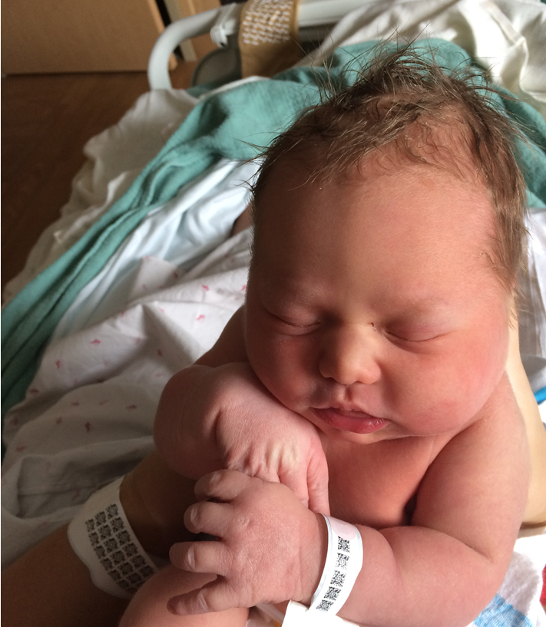
I did my part!!!
Walter Samuel Backus Feldman
“Wally”
…looking forward to attending public school

Slide 10
In response to declining enrollments and increasing property tax rates, Act 46 of 2015 made several changes to the education finance system:
Encourages (through tax incentives) districts to merge in order to share costs and provide consistent K-12 education
Introduced simplified “yield” amounts to serve as the bases for calculating homestead property tax rates and the rate for those who pay based on income
Requires per-pupil spending amount and percent change from previous year to be clearly shown on school budgets presented to voters. 16 V.S.A. §563 D.

Slide 11
In light of the recent changes, here is how education property tax rates are computed under current law for the three types of payers:
Non-residential Property
(basically all non-Homestead)
Homestead Property
Income (for homesteads)

Slide 12
But first!
Because we have a statewide education fund, with shared responsibility, the State applies a correction factor to town tax rates that reflects how the town listed property values differ from fair market values (sale prices).
This correction factor is known as a Common Level of Appraisal or CLA. CLAs less than 1.00 (100%) indicate property is generally listed for less than fair market value, and values more than 1.00 indicate property is generally listed for more than fair market value.
CLAs come from a statistical study the Division of Property Valuation and Review (PVR) does every year called the “Equalization Study.”

Slide 13
Non-residential (NR) Property
Example: Montpelier 2018 to 2019 (FY19) property tax year
Town CLA Town Rate
Statewide Rate
$1.580 ÷ .9231 = $1.71 (per $100 of property)
Tax on $250,000 is $1.71 x $2,500 = $4,275

Slide 14
Homestead Property
Montpelier/Roxbury - 2018 to 2019 (FY19) property tax year
Per-pupil spending ÷ homestead property yield = Rate
$15,924 ÷ $10,220 = $1.56
8 cent tax rate incentive for 1st year of merger
Incentivized Rate ÷ town CLA = Rate
$1.48 ÷ .9231 = $1.60
Tax on $250,000 = $1.60 x $2,500 = $4,000

Slide 15
Homestead Property
Note: Towns are often part of more than one education district. For example, a town might have its own district that covers grades K – 6 and be part of a union district that covers 7-12.
Multiple district example:
East Montpelier - 2018 to 2019 (FY19) property tax year
Per-pupil spending = 48.1% East Montpelier + 51.9% U-32
Per-pupil spending = .481 x $19,645 + .519 x $18,056 = $18,820
Note: Excess spending penalties and merger incentives are applied at the district level. Statutory limits on year over year changes are factored at the town level.

Slide 16
Income (homestead)
More than two thirds of homesteads(Vermont resident households) pay for education based on their household income rather than property value. Those households receive a Property Tax Adjustment (PTA) that is communicated to the town and appears on the bill as “State Payments.” Households with income of less than about $133,000 are eligible for an adjustment
FY19 Property Taxes - PTA = Net Tax Due
PTAs that were credited to FY19 property tax bills were calculated based on FY18 taxes paid and 2017 household income. This is the “lag” in the property tax adjustment system that people often refer to.

Slide 17
PTA (Income Sensitivity) Calculation
Per-pupil spending ÷ income yield x 2% = town income rate
Example: Montpelier household with $75k in income and $250k housesite
$15,924 ÷ $12,380 x 2% = 2.57%
Household Income x town income rate = taxes based on income
$75,000 x 2.57% = $1,929
Taxes based on property – taxes based on income = PTA
$4,000 – $1,929 = $2,071 applied to FY20 bill

Slide 18
PTA Calculation - Details
For households with income less than $90,000, the PTA only covers up to the first $400,000 in house-site value and taxpayers pay regular property taxes on any overage
For households with income greater than $90,000, the PTA only covers up to the first $225,000 in house-site value
Households with income less than $47,000 are also eligible for an additional adjustment sometimes called “super circuit breaker” or “homeowner rebate.” This additional adjustment ensures that total taxes, education and municipal, remaining after the first adjustment do not exceed a specific percentage of their income.

Slide 19
*Other sources are: 25% of Meals & Rooms tax, 33% of Purchase and Use tax, Lottery, Medicaid Transfer, Wind & Solar

Slide 20
Now it all makes sense, right?

