Slide 1
Thank you to
Aaron Rosenblum, Portland Public Library
&
Jessica Burton, Southern Maine Conservation Collaborative

Slide 2
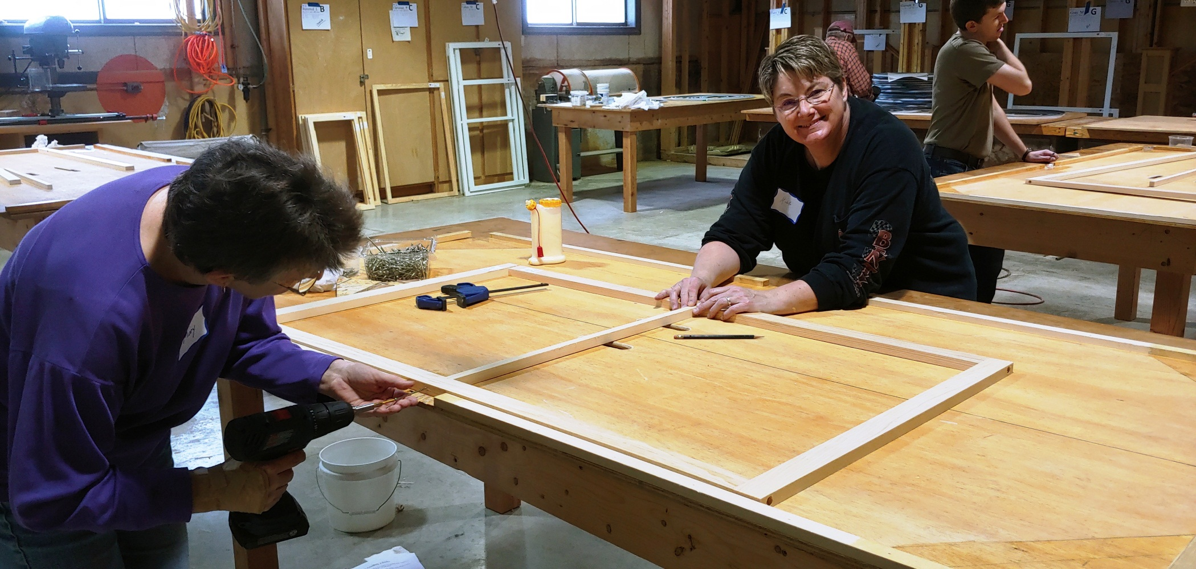
The Story of Window Dressers
A PechaKucha Presentation
PechaKucha is a storytelling format
20 slides, 20 seconds each.

Slide 3
Why insulate your windows?
Heat loss through windows is responsible for 25%–30% of residential heating energy use.

Slide 4
Air Leakage
Conduction
Radiation
Convection

Slide 6
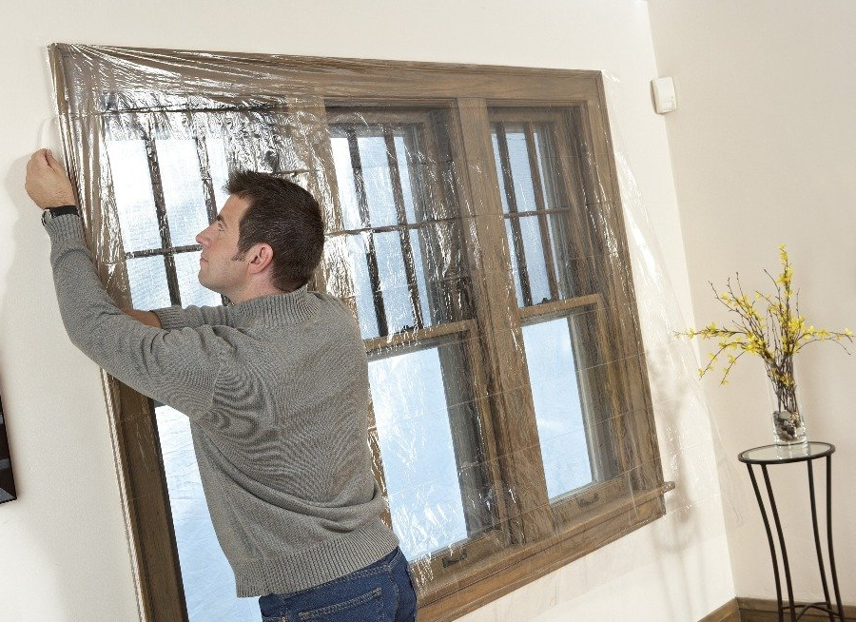
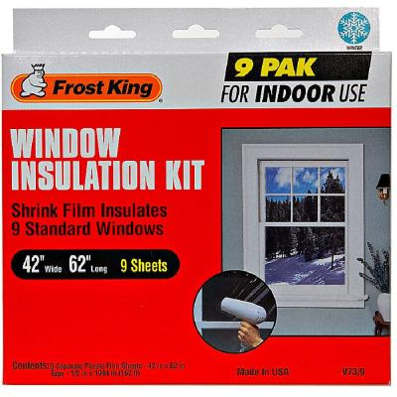

Slide 7
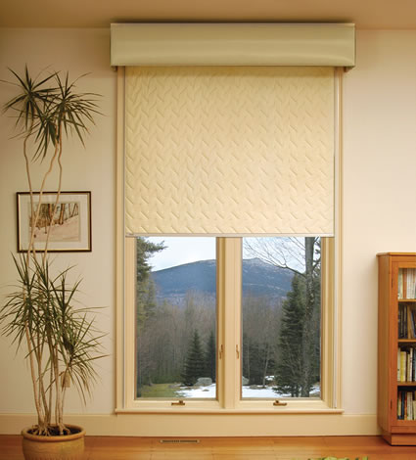
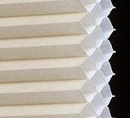
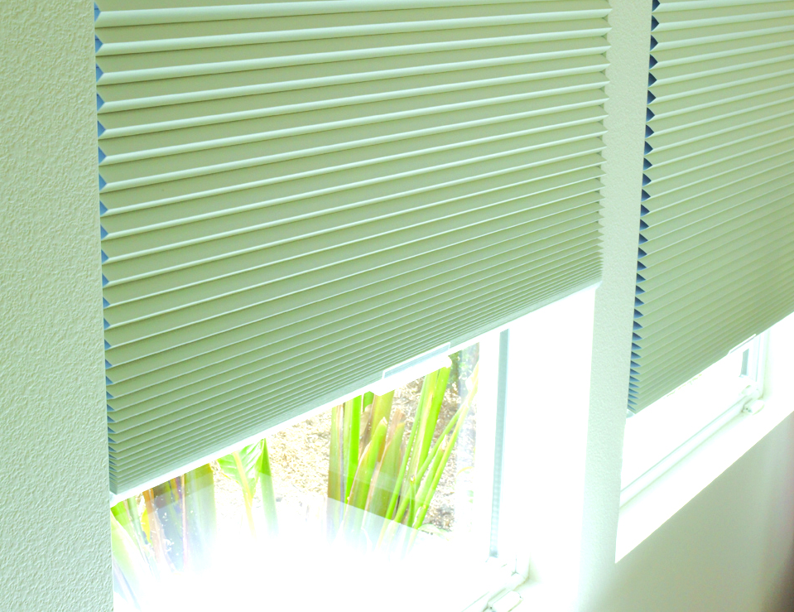

Slide 8
Why WindowDressers
Insulating Window Inserts?

Slide 9
High Quality Inserts
Three sealed, insulating air spaces
Reduce/eliminate condensation
1
2
3

Slide 10
Low Cost
WindowDressers:
$39 per avg. insert (Pine)
$50 per avg. insert (White)
IndoWindows: $260 per avg. insert
Replacement Windows: $750+ each

Slide 11
Save Money on Fuel Bills
Expect a 10-20% reduction in your first winter

Slide 12
Cozy & Comfortable!
“It is simply amazing! Last winter, this kind of weather would have kept me covered in piles of blankets in a chair with no courage to venture out! I didn’t think it would make much of a difference as I already used the plastic. But it is drastically different. I am very grateful!”

Slide 13
Lower CO₂ emissions
=
Better for Mother Earth

Slide 14
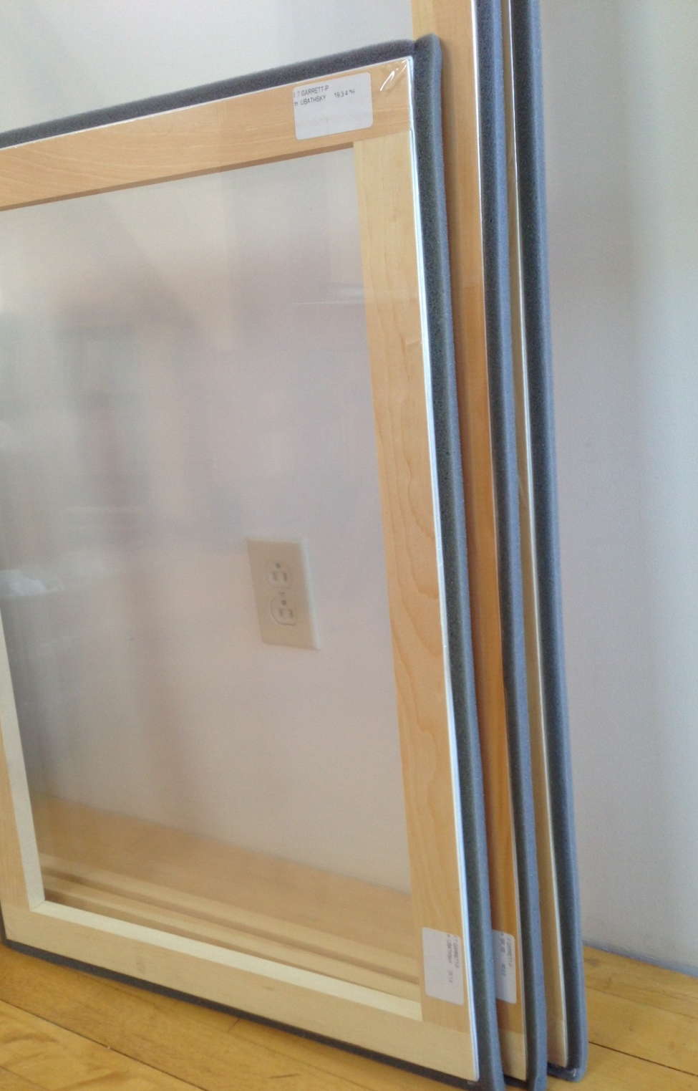
Reusable
When you’re done with winter, they’re stackable, each with its own unique label

Slide 15
Notes:
So

Slide 16
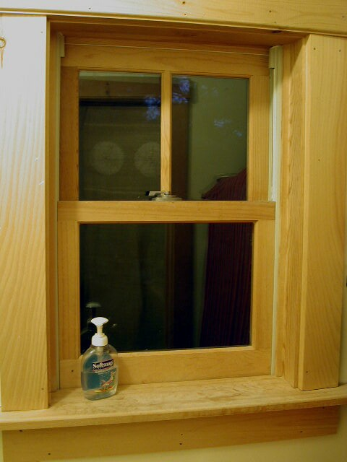
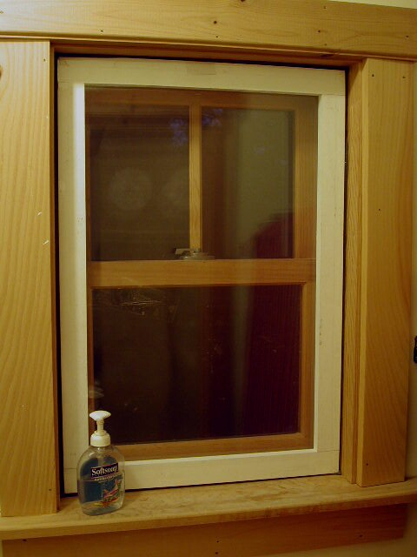
After
Before
Notes:
This is what the difference looks like if you make and install one of these insulated inserts.

Slide 18
Help for others: 25-35% of our inserts are given to low income households at no charge.
Notes:
Grant funding helps support our low-income program, ensuring that all of our neighbors have access to our money-saving, house-warming inserts, regardless of their income level.

Slide 19
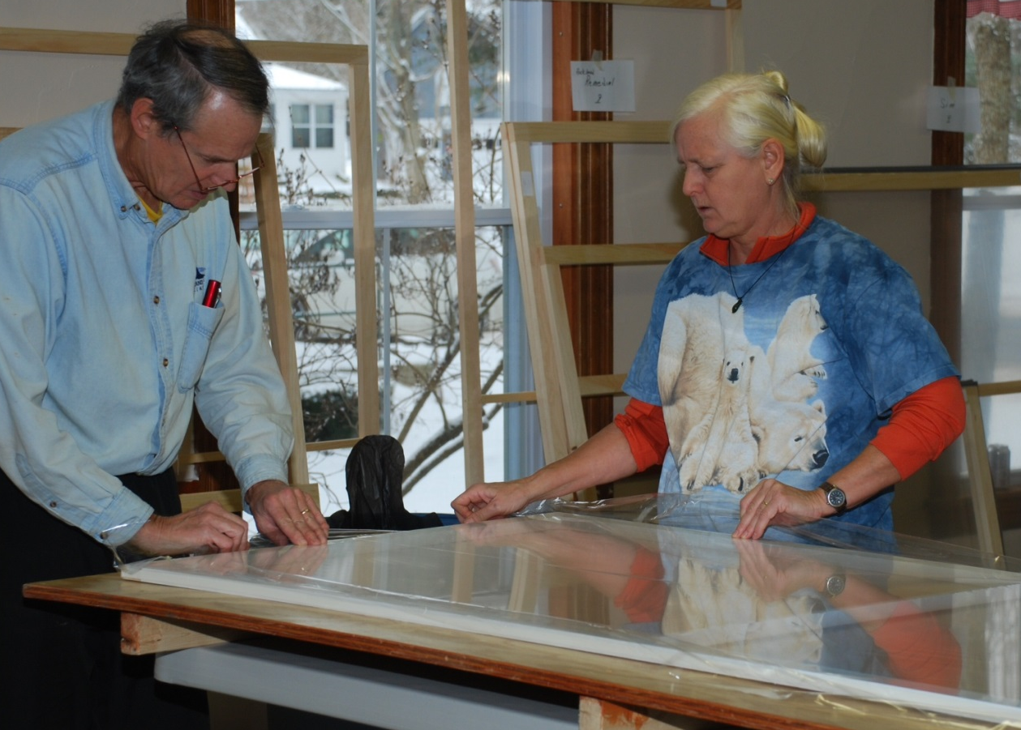
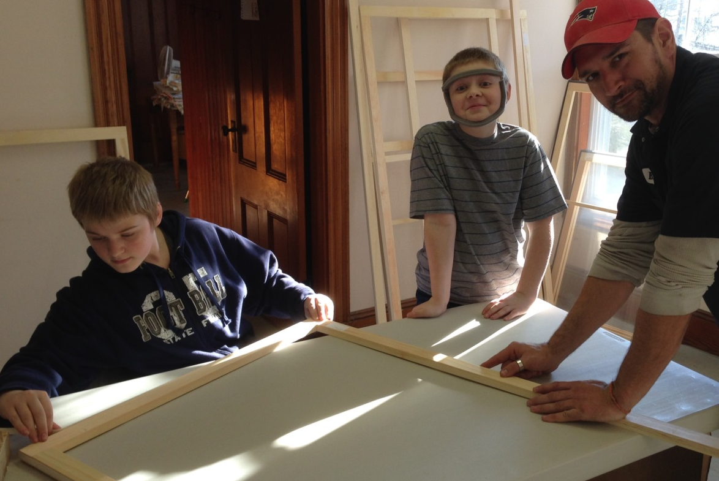
Community Builds = Building Community

Slide 20
Updated statistics
Since 2010:
42,567 inserts built to date
Estimated 3.4 million gallons of heating fuel saved
Looking Ahead!
47 Community Builds across Maine, Vermont, and NH
9,400 inserts this year.

Slide 21
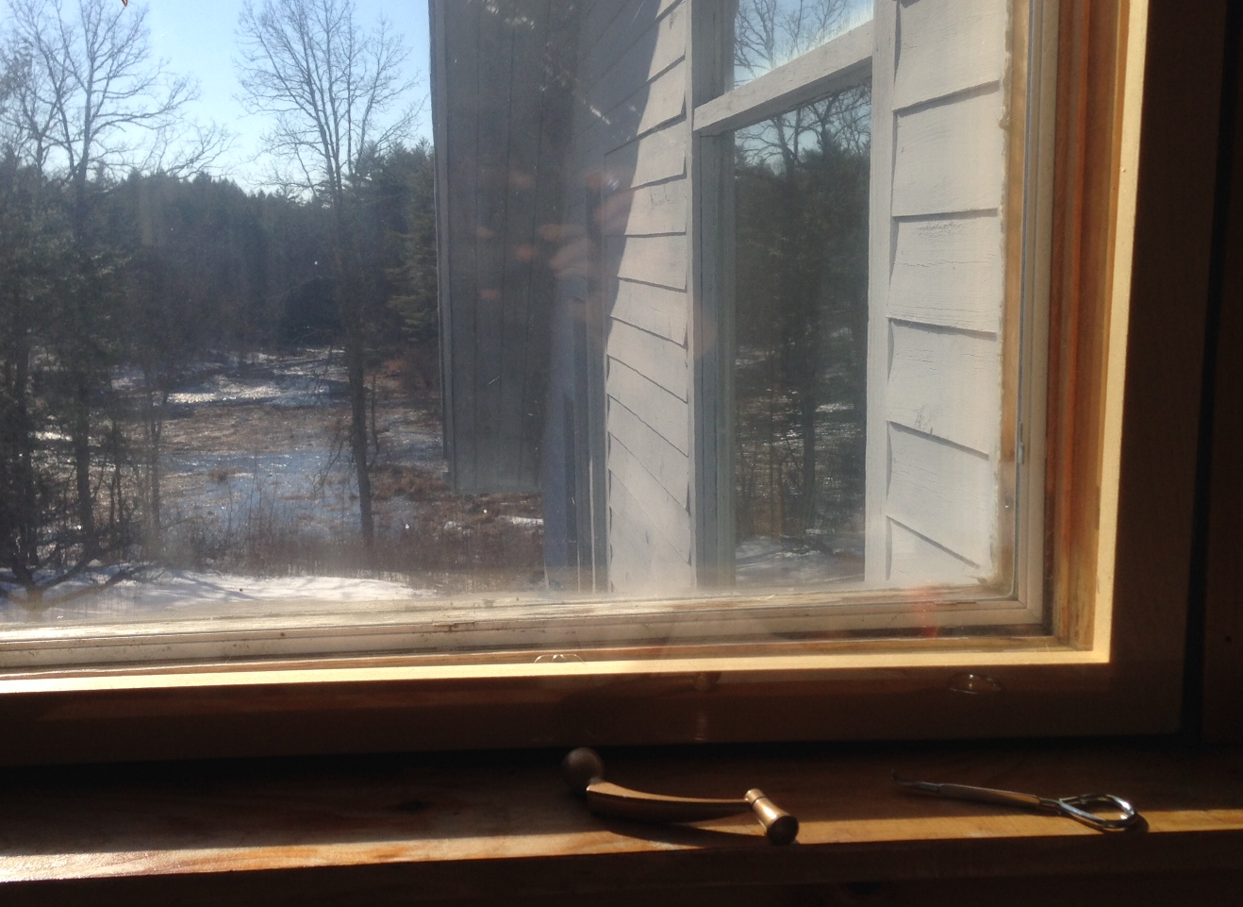
Enjoy the View all day long
Notes:
Completed insert, inserted. Winding handle removed. Paint can opener ready for springtime removal to let the fresh air in this window.

Slide 22
Contact Us!
South Portland Local Coordinators
Jessica Williams
207-831-8439
jsw613@hotmail.com
Taylor Strubell
319-230-2227
tjstrubell@gmail.com
Join Us!
www.windowdressers.org

Slide 23
Thank You!
Questions?

