Slide 2
Brief history of DVFiber
Mission statement
Current status
Future plans
Community participation

Slide 3
DVFiber History and Current Profile
Founded by 5 towns in April 2020
Now 24 towns in 3 counties
60+ volunteer board and committee members
Diverse accomplishments and strong motivation
Governing Board, officers, and 4 Committees focus on strategy and oversight
Obtained consulting guidance for partner selection and contracting
GWI, BDCC, RISI are contracted to provide professional services
Recruited Executive Director
Page 3

Slide 4
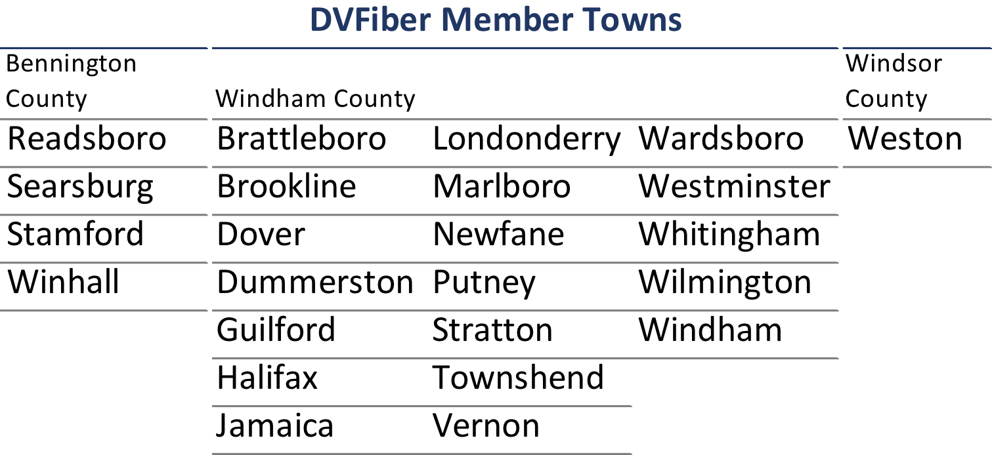
DVFiber has committed to providing universal service to the on-grid underserved and unserved locations in its 24 towns.

Slide 5
Mission
To provide affordable, reliable high-speed Internet service that will support economic development and expand educational opportunities within the district.

Slide 6
The internet is an essential service for every Vermonter.
The future of our community’s health depends on closing the digital divide and driving economic diversity.
Our vision and principles are our core beliefs in setting a course to provide access to not just some but to ALL.

Slide 7
Access Vision and Principles
Equity
Performance
Affordability
Reliability
Privacy

Slide 8
Vision and Principles Equity
No one should face a barrier to internet access based on where they live.
Priority installation will be given to unserved or underserved areas.

Slide 9
Vision and Principles Performance
The internet should be fast and reliable, and the quality should improve over time as the uses of the internet continue to evolve.
It is capable of at least gigabit-per-second service to all fixed locations, with substantial additional capacity for future demand and supporting rapid deployment of new technologies.

Slide 10
Vision and Principles Affordability
Cost should not be a barrier for any Vermonter who wants to connect to the internet.
The design minimizes capital and operating costs
Long useful lifespan
Low-cost upgrade paths to meet future demands
Not encumbered by profit mandate

Slide 11
Vision and Principles Reliability
The infrastructure will be reliable and resilient, designed to withstand equipment failures, power outages, natural disasters, or man-made disasters unique to Vermont’s topography

Slide 12
Vision and Principles Privacy
Vermonters must be able to determine how their data is or is not used. Our network will support net neutrality. The network’s components will be secured against physical and electronic threats.

Slide 13
Accomplishments to Date
Pre-construction efforts
$4.1M pre-construction grant
Organizational infrastructure built: legal, accounting, auditing, technical and business consulting, grant management/reporting
Completed detailed contract negotiations with Great Works Internet (GWI):
planning, pre-construction, construction, operations, maintenance,
customer connection, and ISP services, and Voice over Internet Protocol (VoIP) (pending)

Slide 14
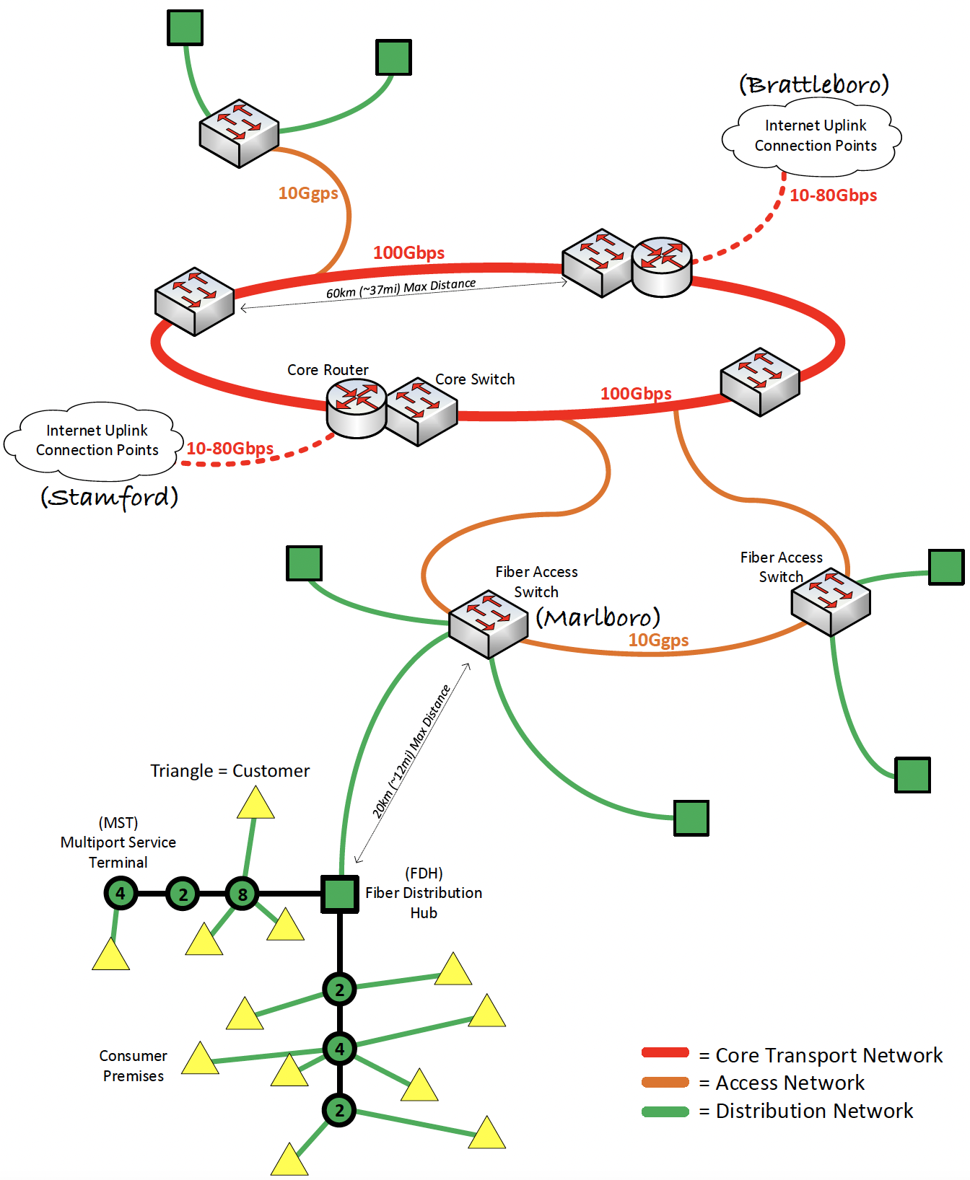
Accomplishments to Date
High-level design completed;
Ring architecture
6 core transport networks
Detailed design for first 36 months of construction largely completed;
3 core transport networks
Fiber service areas (FSAs)
Fiber distribution hub
Multiport service
terminals
• On-going design
7 completed
150+ planned
Windham FSAs in northern and central rings.
Notional Architecture

Slide 15
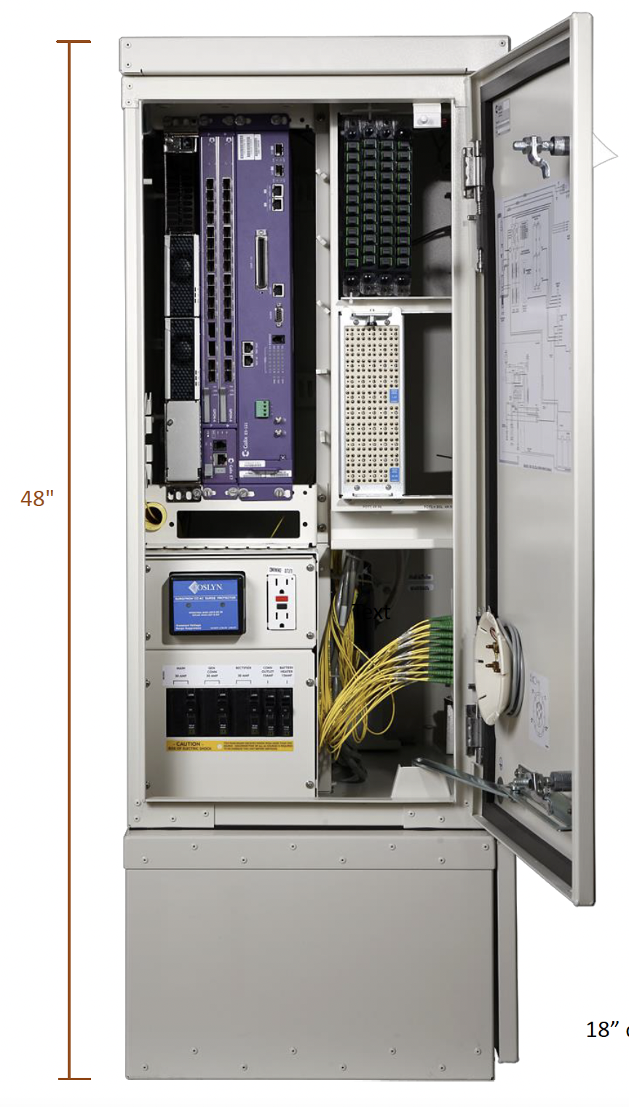
Resilient Design
Access POP
connects core transport network to the Internet
The network will tolerate fiber cuts at its various sections with little impact on services;
Internet services will be delivered using routers in the core points of presence (POPs);
Batteries can run the facility for 8 to 24 hours. In addition, core sites will have automatic generator systems.

Slide 16
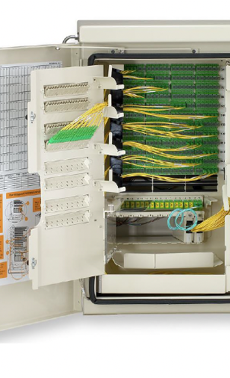
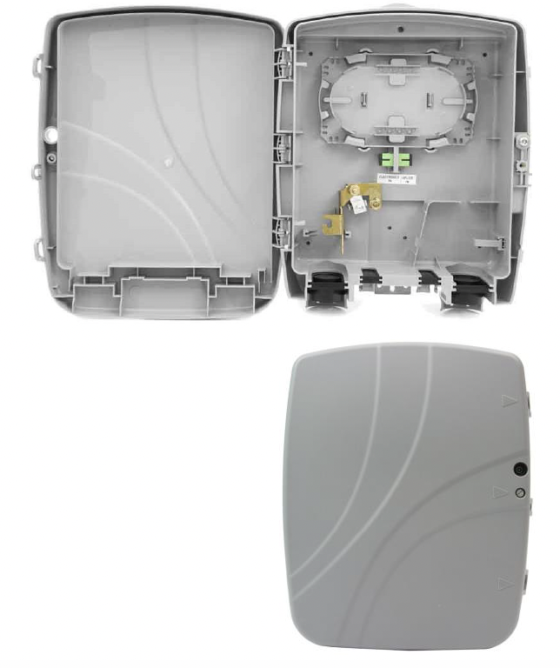
Fiber distribution hub
connects field service areas to the access network.
Utility Pole Mounted
Multiport Service Terminal
Connects your home to the Internet

Slide 17
Accomplishments to Date
Pre-construction efforts
Cable purchase: 300 miles of 144, 78, and 24 strand fiber optic cable
Pole make-ready underway
inspections, pole preparation, permit fees for 12,000 poles
pole replacement for substandard poles
one-touch make-ready
Green Mountain Power is subsidizing reducing cost per un/underserved location $2K.

Slide 18
Accomplishments to Date
FY 2021 audit completed:
Favorable opinion: a clean audit;
Financial controls in place.
Financial plan developed:
10-year plan; grant and capital funding
36-month grant funding for construction for un/underserved locations
Capital funding to supplement served locations

Slide 19
Accomplishments to Date
Policies established
Connection policy
Standard connections are free
Non-standard at cost above standard connection.
Customer accessibility and affordability policy
“Cost should not be a barrier for any resident who wants to connect to the Internet.”
DVFiber has plans to link customers with assistance for connection and subscription costs;
Windham donation of ARPA funds could subsidize non-standard connections for low-income households.

Slide 20
American Rescue Plan Act (ARPA)
The emphasis of DVFiber’s initial network build-out is placed on unserved and underserved areas in member towns.
-Provide an unconstrained donation
-Provide a letter of credit, so needed materials for construction can be purchased sooner
-Cover the cost of the line drops to homes and businesses
-Cover the cost of fiber to all “anchor institutions”,
e.g. town offices and libraries
VCBB will match ARPA town fund donations
Jamaica plus two other towns have committed
Three more under consideration
Jamaica commitment will leverage additional $22.1K

Slide 21
What’s Happening Right Now
Construction Grant Awarded by Vermont Community Broadband Board (VCBB)
Design, financial plan, audit report, and business plan were critical elements in receiving grant
$21.9M grant
Funds 18-24 months of construction
IIJA (Infrastruction Investment Jobs Act) BEAD (Broadband Equity Access and Deployment) grant to complete 36-month program
Bond/alternative loan funded follow-on

Slide 22
Construction Begins
GWI will be our technical partner for service provision in our 24-town district
The construction build-out will happen in 7 construction stages
Construction will reach all unserved and underserved homes in district
Construction will provide guaranteed symmetric 100/100 MBs to 800/800 MBs service
The earlier phases will focus on areas with the most unserved and underserved locations with the highest ‘’take rate’’ because of less competition.
Windhams unserved and underserved will be reached in phases 3 & 4
Built in 3 “rings”
Windham in northern ring

Slide 23
When Will Windham’s Construction Happen?
Our build-out will happen when the northern ring is built
Stages 3 and 4
Once build-out begins, Stage 3 will be completed in 24 months

Slide 24
What Do We Need from Windham?
• VCBB grant will match ARPA town fund donations:
Jamaica plus two other towns have committed
Three more under consideration
Jamaica commitment will leverage additional $22.1K.
• Participate in our marketing program
DVFiber provides advertising
DVFiber provides a social media campaign
DVFiber provides mail, door hangers, poster outreach materials (local volunteers needed to distribute)
Provide updates/links on town website
Help organize/publicize town information meetings
Word-of-mouth informal networks
• Volunteers needed
Please contact David Cherry, Windham DVFiber board representative, at David.Cherry@DVFiber.net to help.

Slide 25
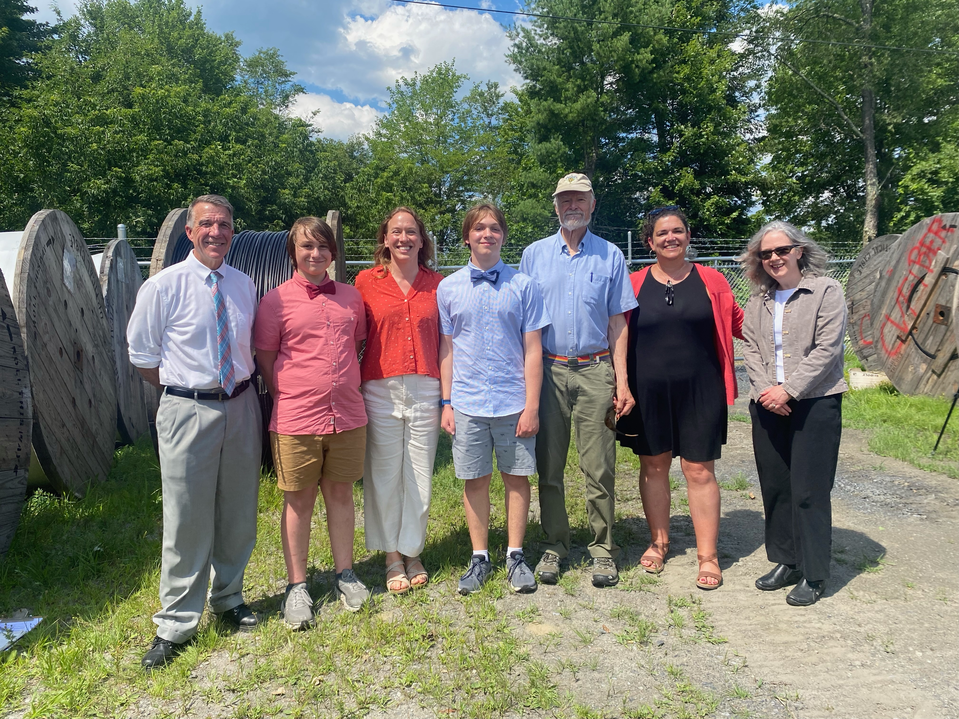
Governor Announces Construction Grant

Slide 26
How Fast is 100/100?
“Broadband” starts at 25/3 (download/upload);
You can stream HD videos on Netflix at 5 Mbps down or 4K Ultra-HD at 25;
Zoom and other teleconference platforms work best with at least 5 Mbps down and 1 up;
The more devices you connect at once and the more apps that are open, the more speed you need;
100/100 is fast enough for videos, gaming, or teleconferencing on several devices at once;
DVFiber will have the reserve capacity to grow to GHz speeds and beyond.

Slide 27
DVFiber: The People’s Internet
Owned by the citizens of the 24 member towns and governed by representatives appointed by their Select Boards

