Slide 1
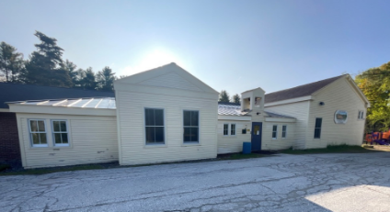
Windham Elementary School Re-Purpose Study
PREPARED FOR:
TOWN OF WINDHAM
Stevens & Associates, p.c.
95 Main Street, Brattleboro, Vermont

Slide 2
3rd Meeting Agenda
Project Understanding and Approach
Population & Demographics
Review Existing Building Conditions
4. Information Gathering – Public Engagement
5. Alternates w/ Rough Order of Magnitude Costs – (Broad Brush w/assumptions, accuracy -50% to +75% .
Stevens & Associates, p.c.
95 Main Street, Brattleboro, Vermont

Slide 3
PROJECT UNDERSTANDING & APPROACH
1. Town of Windham hired Stevens Associates to perform a feasibility study with rough order of magnitude (ROM) costs as to future options for possible uses for the Windham Elementary School Building.
2. The school building may be offered to the town of Windham for $1. This sum is separate from any real estate fees, closing costs, title documents and other costs to the town associated with the acquisition of this piece of real estate. Windham will retain Stevens and Associates to assist in a feasibility study to examine the options.
3. The team will rely on the Facility Condition Assessment prepared for the Vermont Agency of Education -FCA Phase Two last summer.
4. There will be two information gathering meetings.
5. A third meting will take place to discuss the findings. The intent is to have the necessary information and ROM costs of options so that the Selectboard can determine whether it is in the highest and best interests of the town to acquire this building. Costs including deferred maintenance will be taken directly from the Facility Condition Report report and prioritized reuses of the building will be given a ROM ranking with a consideration of low, moderate and high for their undertaking.
6. The study will be completed in February 2025, so that the Selectboard and the Town will have this information before Town Meeting on Tuesday, March 4.
7. This feasibility study is being funded by a grant received from Vermont Council on Rural Development, revising an earlier proposal for the Municipal Technical Assistance Program.
Stevens & Associates, p.c.
95 Main Street, Brattleboro, Vermont

Slide 4
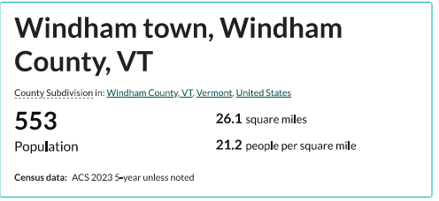
POPULATION AND DEMOGRAPHICS ( 2023)

Slide 5
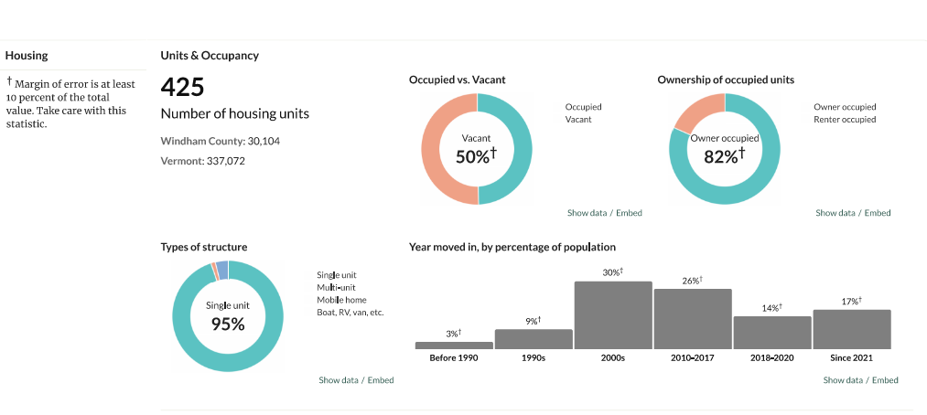
HOUSING & HOUSHOLDS

Slide 6
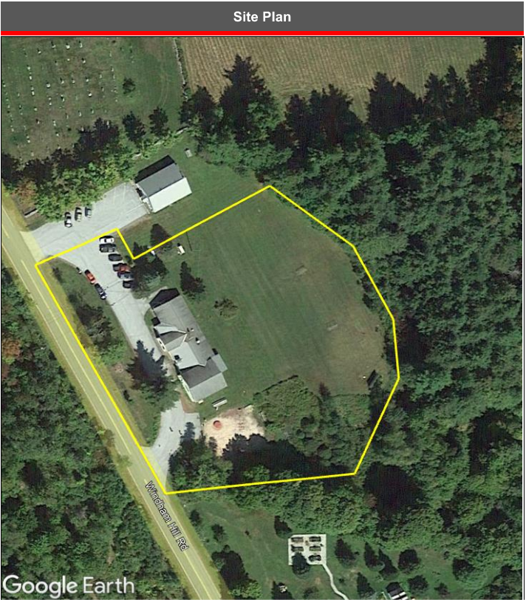

Slide 7
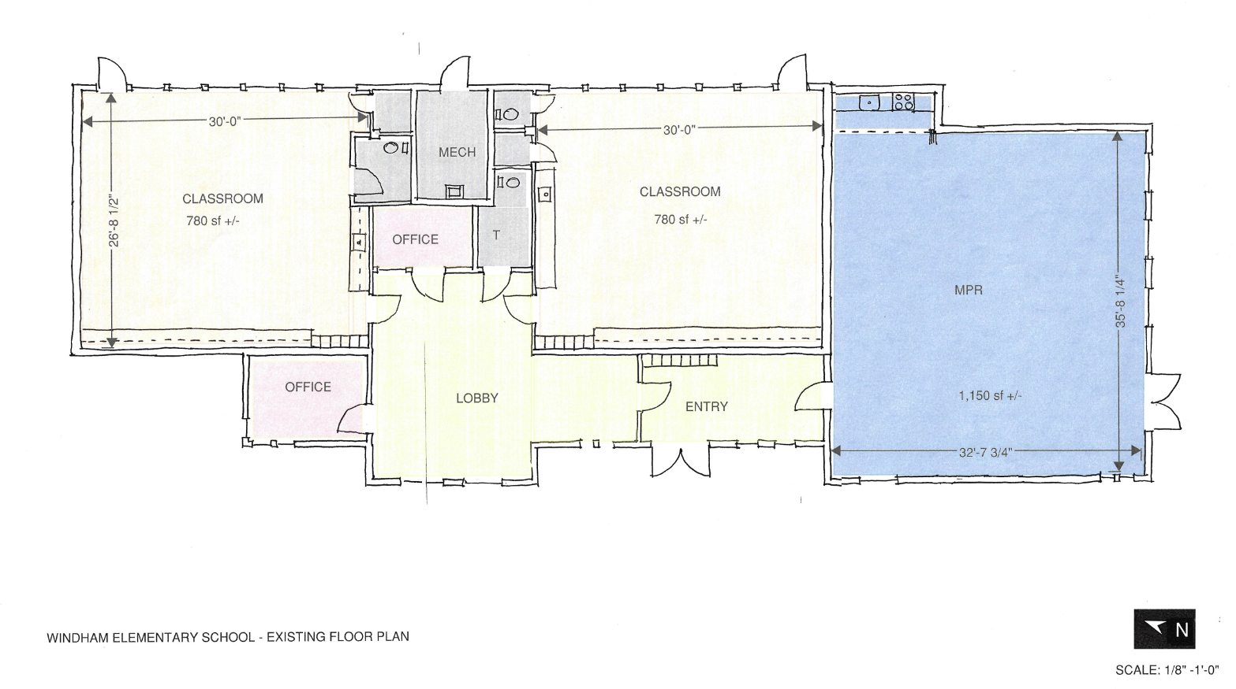

Slide 8
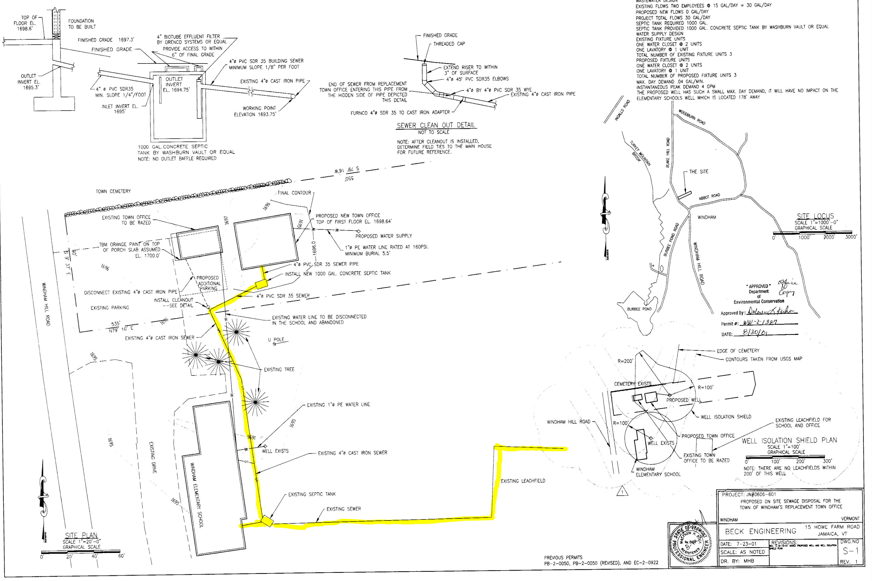
NOTE: A Permit Discovery Effort will be needed and is beyond the scope of this study:
ACT 250 ( have? Or not?)
WW Permit
Storm Discharge Permit
Wetlands Permit
Water System Permit to Operate
Others ..
15
14
7
Current Student Population 79
Total 5 yr Projection K-5 = 169 Students
WATER , SEPTIC & SEWER
Current Capacity – 44

Slide 9
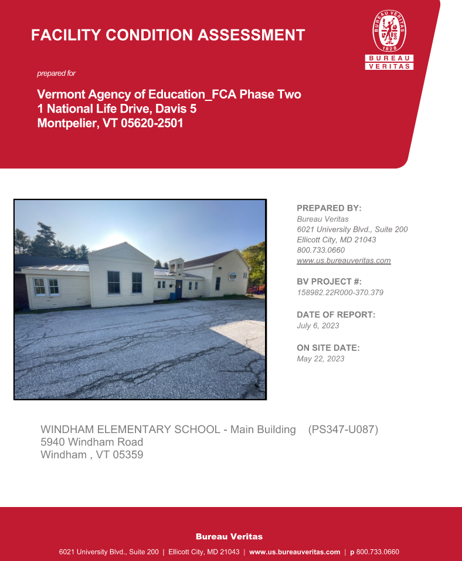
FACILITY CONDITION ASSESSMENT

Slide 10
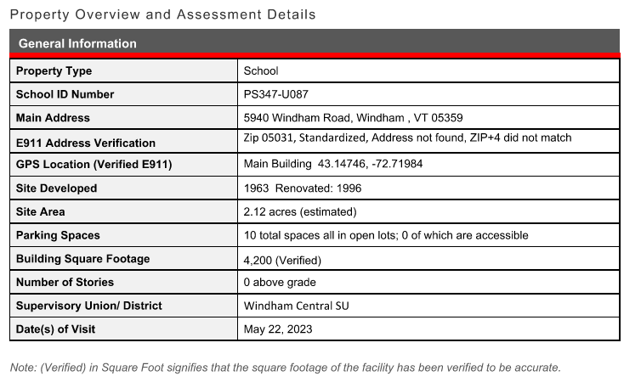
PROPERTY OVERVIEW
AND ASSESSMENT DETAILS

Slide 11
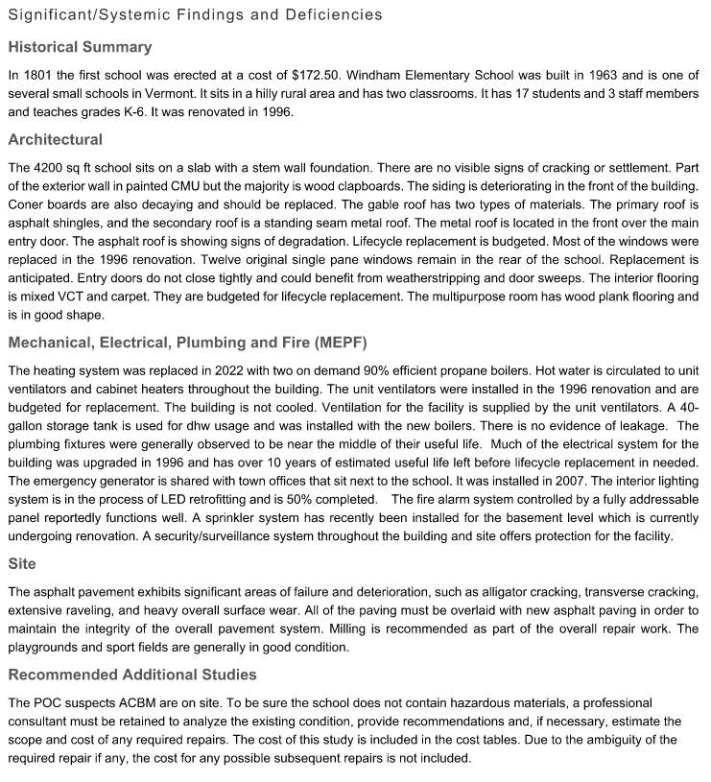

Slide 12
FACILITY CONDITION INDEX (FCI)

Slide 13
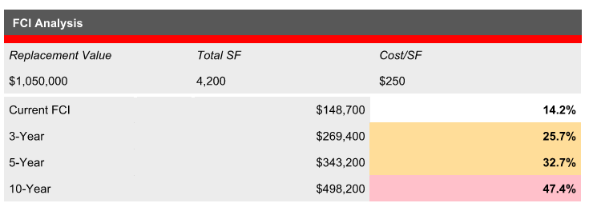
NewBrook
Windham Elementary
Townshend Elementary
Jamaica Village School

Slide 14
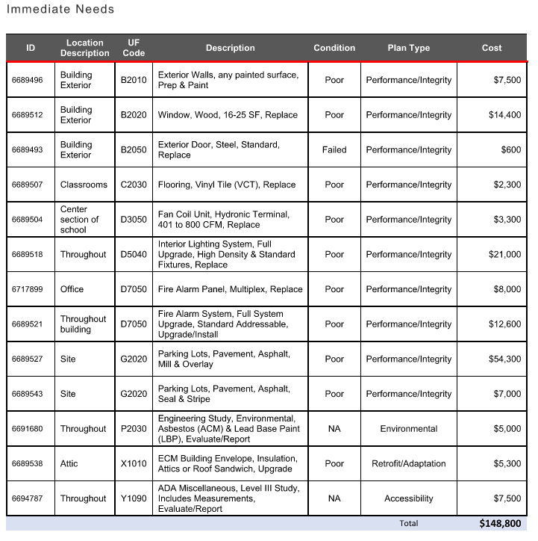

Slide 15
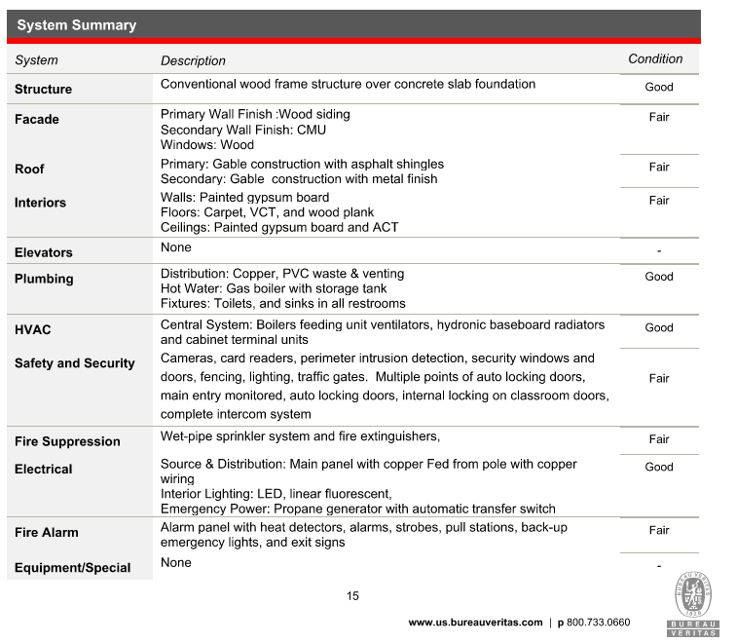
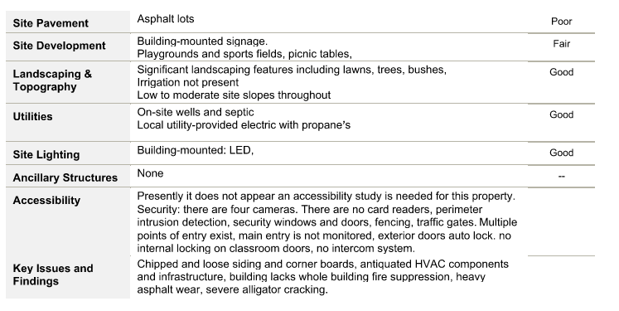

Slide 16
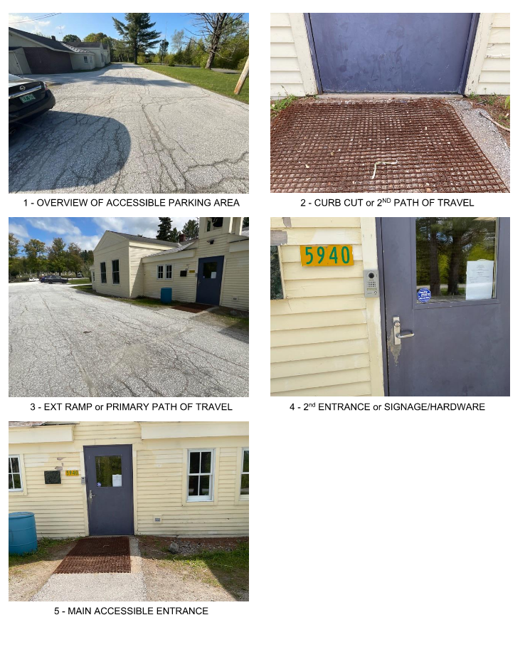
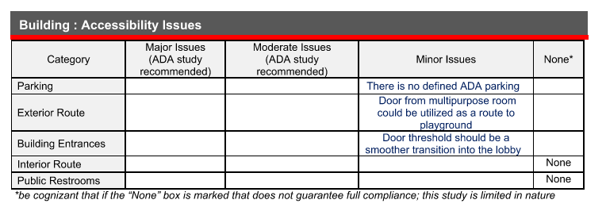
ADA
ACCESSIBILITY
ISSUES

Slide 17
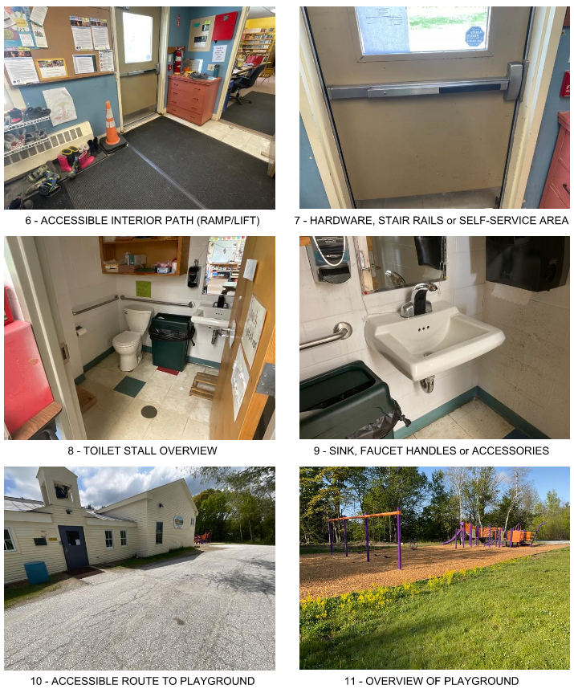

Slide 18
IDEA GATHERING WORKSHEET
What does Windham need that this school building/property could provide?
What would you like to see this building become?
I would go to the Elementary School if it was a ________ or if it offered ______________.
Other Thoughts and ideas.

Slide 19
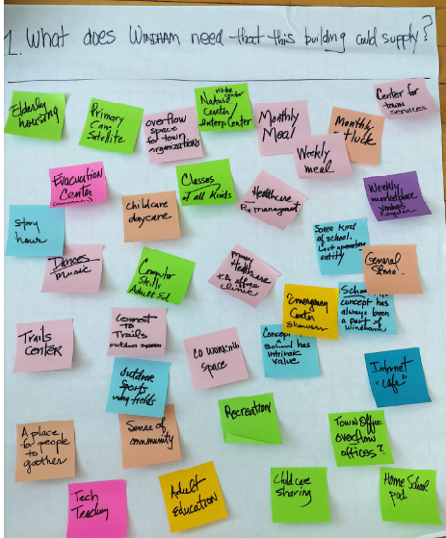
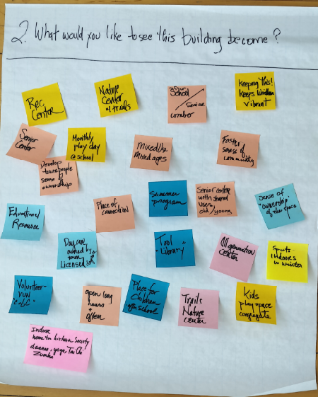
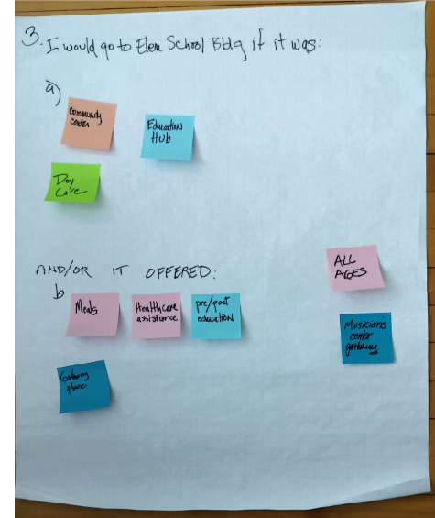
IDEA GATHERING WORKSHEETS

Slide 20
What does Windham need that this building/property could supply?
Senior Housing
Primary Health Care Satellite
Overflow space for Town Offices /Organizations
Visitor Center/Nature Center
Monthly meal
Monthly potluck
Weekly meal
Center for town services
Story hour
Evacuation center – generator
Dances/music
Childcare/daycare
Classes of all kinds
Healthcare/RX management
Some kind of school/last operating entity
Weekly marketplace – vendors regular
Computer skills adult ed
Primary healthcare/PA office/clinic
Trials center
Connect to trails/outdoor space
Coworking space
Concept of a school has intrinsic value
Emergency center showers
School concept has always been a part of Windham
General Store
Outdoor sports using fields
A place for people to gather
Provide a Sense of Community
Recreation
Technology Teaching
Adult education
Childcare sharing
Town office overflow/offices
Homeschool pod
What would you like to see this building become?
Rec center
Nature center of trails
After school/senior combo
Keeping this! Keeps Windham vibrant
Senior center
Monthly play day at school
Mixed use/mixed ages
Foster sense of community
Develop townspeople sense of ownership
Educational resource
Daycare owned by town (licensed daycare)
Place of connection
Summer program
Senior center with shared uses (old/young)
Sense of “ownership” of the space
Tool “library”
All generation center
Sports – indoors in winter
Volunteer – vun “C of C”
Open long hours + oftenPlace for children after school
Trails nature center
Kids play space + congregate
Indoor home to historic society – dances, yoga, Tai Chi, Zumba
Adult Day Care Center
New Fire Station
I would go to the elementary school if it was:
A
mmunity center
Community Center
Education Hub
Daycare
Meals
Healthcare assistance
Pre/post education
Gathering place
All ages
Musician’s center gathering

Slide 21
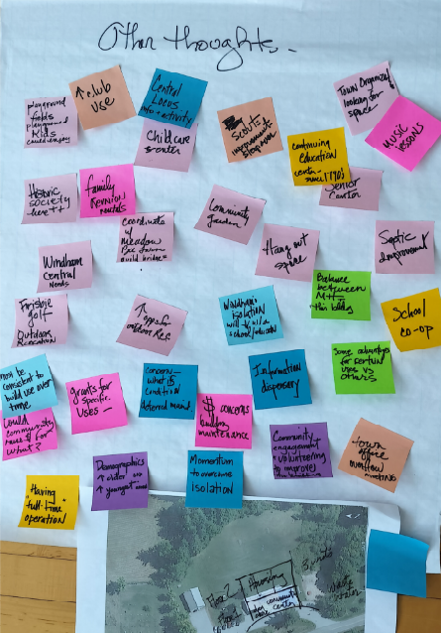
Other thoughts –
Playground fields – playground kids could enjoy
Club use
Central locus info + activity
Childcare center
Scouts improvement sleepover
Continuing education center – since 1790’s
Town organization looking for space
Music lessons
Historic society here
Family reunion rentals
Coordinate with Meadow Bee Farms – build bridges
Community garden
Hang out space
Senior center
Septic development
Windham central needs
Frisbee, golf – outdoor recreation
More options for outdoor rec
Windham’s isolation will go down with a school/education
Balance between MH + this building
School co-op
Must be consistent to build use over time
Could community make money for what?
Grants for specific uses?
Concern – what is condition (deferred maintenance)
Money concerns/building maintenance
Information dispensary
Some advantages for certain uses vs others
Having “full-time” operation
Demographics – more older oak, more younger acorn
Momentum to overcome isolation
Community engagement + volunteering to improve the building
Town office overflow meeting

Slide 22
SHARED PRINCIPLES AND OBJECTIVES
BRINGS PEOPLE TO GATHER IN A MULTI-GENERATIONAL WAY
A PLACE TO SOCIALIZE
A PLACE TO PROMOTE LOCAL CULTURE & PRESERVE THE TOWN’S HISTORY
THE SCHOOL HAS ALWAYS BEEN A PART OF WINDHAM
CONCEPT OF A SCHOOL HAS INTRISIC VALUE
A PLACE FOR PEOPLE TO GATHER
FOSTERS A SENSE OF COMMUNITY
KEEPS WINDHAM VIBRANT
SCHOOL BUILDING AND GROUNDS ARE A VALUABLE ASSET TO THE COMMUNITY
PROGRAMS SHOULD NOT COMPETE WITH MEETING HOUSE
PROGRAMS COULD BE A SOURCE OF INCOME REVENUE

Slide 23
EDUCATIONAL HUB – From Acorn to Oak
Historic Society
Resource for Home Schooling
Childcare Sharing
Licensed Day-Care Pre-School
Adult Continuing Education Classes – All Skills
Adult Day Center
Art Classes
Music Classes
Seminars and Workshops
VISITOR/WELCOME CENTER
Tourist/Travel Information Lobby
Refreshments/Café
Local Attractions and Displays
NATURE CENTER
Visitor Center
Connect to Trails
Maps
Outdoor Space
Summer Camps
Boys and Girls Scouts
Coordinate with Meadow Bee Farms
HOUSING
Senior
HEALTH CARE
Primary Health Care Center
Visiting Nurse
PA Office
TOWN ADMINISTRATIVE OFFICES
Overflow Offices
Record Storage
Provide Fiber Optic Internet
Selectboard/Committee Meeting Space
EMERGENCY EVACUATION CENTER
Generator
Food Prep and Storage
Bathrooms/Showers
Heat
Temporary Shelter
NEW FIRE STATION
New 2 Bay Fire Station
Salt and Sand Sheds
Use Existing School for Fire Training/Equipment

Slide 24
RECREATIONAL CENTER – Acorn to Oak
Indoor Heated Pool – (Showers-Lockers)
Fitness Center – Exercise Equipment – Yoga – Tia Chi, Zumba
Host Indoor Team Sports – Basketball, Pickleball, Volleyball, Badminton
Host Outdoor Team Sports – Summer/Fall Soccer, Pickleball, Basketball, Field Hockey, Frisbee, Golf, Track, etc.
Winter Sports - Cross County skiing, Snowshoeing, Tubing
Outdoor Playground
Open Fields
Venue Space for Family Reunions, Clubs and Organizations
INDEPENDENT SMALL BUSINESS SUPPORT SPACE
Vendors / Market Place
Co-working space
Hot Desks
Internet Access
Café
COMMUNITY EVENTS/GATHERINGS
Community Gardens
Outdoor Events 4th of July, Memorial and Labor Day
Regularly Hosted Meals / Potlucks
Dances
Music
Slide Shows
Food/Clothing Swaps
Fix-it days
Tool Swaps

Slide 25
$$ Lowest Cost Projects:
Use the existing building footprint
No increase on demand of water and sewer capacity.
Minor modifications to the interiors.
Minor changes to site, parking, fields.
ROM
Immediate Needs $148,000 x 3 = $444,000
Range $444,000 – $650,000
Town Offices
ED HUB/ REC-CENTER
(w/HISTORIC Society )
EDUCATIONAL HUB
COMMUNITY EVENTS/GATHERINGS
RECREATIONAL CENTER – No POOL- As is
Alt 1. NATURE CENTER – Min. changes to site
Alt 2. VISITOR/WELCOME CENTER
Alt 3. HEALTH CARE

Slide 26
$$$ Moderate Cost Projects:
One story addition to building.
Potential increase on water and sewer capacity.
Modest reconfiguration of interiors.
Modest changes to site/parking/fields
ROM
Immediate Needs $148,000 x 3 = $444,000
Does not include Site Costs/Permits/A & E etc
Range $550,000 – $800,000
Historic Society
TOWN ADMINISTRATIVE OFFICES
– with new Vault
Recreation – Multi-Purpose
Community Events
Town offices
Alt1. INDEPENDENT SMALL BUSINESS SUPPORT SPACE
Base: EMERGENCY EVACUATION CENTER
– added showers
RECREATIONAL CENTER – No POOL- As is
COMMUNITY EVENTS/GATHERINGS

Slide 27
$$$$ Major Cost Projects:
Adding a New building
Adding an Addition
Adding a Second Story
Increase the demand on the water and sewer capacity.
Modest/major reconfiguration of interiors.
Extensive site work/parking lots/fields
ROM Each Alt
4,000 sf x $450-$600 sf = 1,800,000 -$2,400,000 plus
Does not include Costs for Immediate Needs / Site Costs/Permits/A & E etc
Alt Fire Station
Alt 1. SENIOR HOUSING – Second Story
Alt 2. NEW FIRE STATION ( w/ existing building) New Salt/Sand Sheds
Alt 3. RECREATIONAL CENTER – Addition Indoor Pool
Base: Emergency Evacuation Center w/showers

Slide 28
NEXT STEPS – Things to Consider Consider a Phased Approach; Immediate - Short – Mid – Long Term Master Plan Narrow Down Alternates; Continue Public Engagement Explore Grant Strategies Engage Civil Engineer/Architect to take a more comprehensive look at preferred schemes, program needs, land, site, water/wastewater, and other land permitting implications. Have Building/Soils tested for hazardous materials. OTHERS… END

